Slide 1
Forest Park Southeast, Botanical Heights, Central West End, Medical Campus
Monthly Crime Report: December 2020
Washington University Medical Center

Slide 2
Forest Park Southeast: Summary Notes
25 total crimes in December 2020
-38% change compared to December 2019 (40 total crimes)
2 crime(s) against persons in December 2020
-71% change compared to December 2019 (7 crimes against persons)
327 total crimes in 2020
0% change compared to this time in 2019 (327 total crimes)
47 crime(s) against persons in 2020
0% change compared to this time in 2019 (47 crimes against persons)

Slide 3
Forest Park Southeast: Year to Year Comparison
2019 | 2019 | 2019 | 2019 | 2019 | 2019 | 2019 | 2019 | 2019 | 2019 | 2019 | 2019 | 2019 | 2019
Part 1 Crimes | Jan | Feb | Mar | Apr | May | Jun | Jul | Aug | Sep | Oct | Nov | Dec | Total
Aggravated Assault | 0 | 3 | 1 | 2 | 2 | 4 | 2 | 0 | 2 | 5 | 0 | 5 | 26
Arson | 0 | 0 | 1 | 0 | 0 | 1 | 0 | 0 | 0 | 0 | 0 | 0 | 2
Burgalry | 0 | 0 | 1 | 1 | 0 | 0 | 3 | 1 | 4 | 8 | 3 | 1 | 22
Homicide | 0 | 0 | 0 | 0 | 0 | 0 | 0 | 0 | 1 | 0 | 0 | 0 | 1
Larceny | 7 | 10 | 15 | 12 | 9 | 21 | 17 | 19 | 24 | 35 | 17 | 32 | 218
Motor Vehicle Theft | 3 | 6 | 1 | 2 | 0 | 4 | 6 | 1 | 8 | 3 | 3 | 0 | 37
Rape | 0 | 0 | 0 | 0 | 0 | 0 | 0 | 0 | 0 | 0 | 0 | 0 | 0
Robbery | 1 | 0 | 1 | 1 | 2 | 5 | 2 | 1 | 2 | 3 | 1 | 2 | 21
Total | 11 | 19 | 20 | 18 | 13 | 35 | 30 | 22 | 41 | 54 | 24 | 40 | 327
2020 | 2020 | 2020 | 2020 | 2020 | 2020 | 2020 | 2020 | 2020 | 2020 | 2020 | 2020 | 2020 | 2020
Part 1 Crimes | Jan | Feb | Mar | Apr | May | Jun | Jul | Aug | Sep | Oct | Nov | Dec | Total
Aggravated Assault | 1 | 5 | 4 | 0 | 0 | 6 | 5 | 6 | 1 | 3 | 1 | 0 | 32.0
Arson | 0 | 0 | 0 | 0 | 0 | 0 | 0 | 0 | 1 | 0 | 0 | 2 | 3.0
Burgalry | 3 | 1 | 4 | 1 | 0 | 0 | 4 | 3 | 2 | 2 | 0 | 2 | 22.0
Homicide | 0 | 0 | 0 | 0 | 0 | 0 | 0 | 0 | 0 | 0 | 0 | 0 | 0.0
Larceny | 25 | 15 | 14 | 10 | 8 | 12 | 6 | 13 | 12 | 40 | 40 | 16 | 211.0
Motor Vehicle Theft | 2 | 5 | 2 | 3 | 3 | 2 | 5 | 5 | 2 | 7 | 4 | 3 | 43.0
Rape | 0 | 0 | 0 | 0 | 1 | 0 | 0 | 0 | 0 | 0 | 0 | 0 | 1.0
Robbery | 1 | 6 | 1 | 0 | 2 | 0 | 0 | 1 | 0 | 2 | 0 | 2 | 15.0
Total | 32 | 32 | 25 | 14 | 14 | 20 | 20 | 28 | 18 | 54 | 45 | 25 | 327.0

Slide 4
Forest Park Southeast: Summary Tables
Day of the Week | Number of Crimes
Sun | 4
Mon | 3
Tue | 5
Wed | 1
Thu | 2
Fri | 6
Sat | 4
Total | 25
Part 1 Crimes | Number of Crimes
Arson | 2
Burgalry | 2
Larceny | 16
Motor Vehicle Theft | 3
Robbery | 2
Total | 25
Crimes Against Persons | Number of Crimes
FALSE | 23
TRUE | 2
Total | 25
Time of Day | Number of Crimes
Day | 24
Night | 1
Total | 25

Slide 5
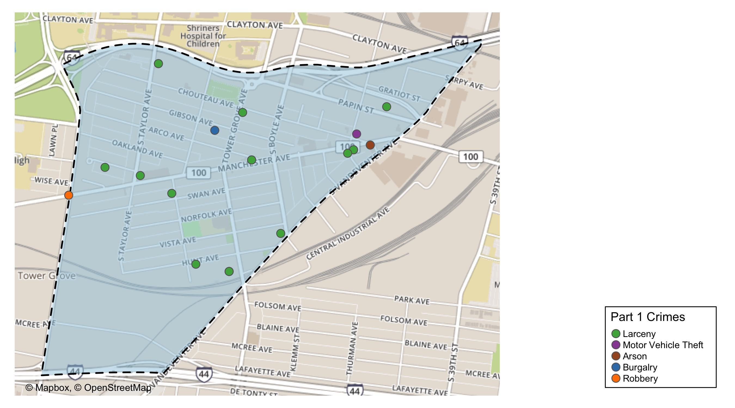
Forest Park Southeast: Total Crime Map

Slide 6
Botanical Heights: Summary Notes
8 total crimes in December 2020
-27% change compared to December 2019 (11 total crimes)
0 crime(s) against persons in December 2020
-100% change compared to December 2019 (2 crimes against persons)
73 total crimes in 2020
-16% change compared to this time in 2019 (87 total crimes)
10 crime(s) against persons in 2020
-38% change compared to this time in 2019 (16 crimes against persons)

Slide 7
Botanical Heights: Year to Year Comparison
2019 | 2019 | 2019 | 2019 | 2019 | 2019 | 2019 | 2019 | 2019 | 2019 | 2019 | 2019 | 2019 | 2019
Part 1 Crimes | Jan | Feb | Mar | Apr | May | Jun | Jul | Aug | Sep | Oct | Nov | Dec | Total
Aggravated Assault | 0 | 0 | 0 | 0 | 4 | 0 | 0 | 1 | 0 | 0 | 2 | 1 | 8
Arson | 0 | 0 | 0 | 0 | 0 | 0 | 0 | 0 | 0 | 0 | 0 | 0 | 0
Burgalry | 2 | 0 | 0 | 2 | 0 | 0 | 1 | 1 | 3 | 0 | 1 | 2 | 12
Homicide | 0 | 0 | 0 | 0 | 0 | 0 | 0 | 0 | 0 | 0 | 0 | 0 | 0
Larceny | 2 | 3 | 6 | 3 | 3 | 3 | 9 | 1 | 5 | 4 | 3 | 5 | 47
Motor Vehicle Theft | 1 | 1 | 3 | 0 | 1 | 1 | 0 | 1 | 0 | 1 | 1 | 2 | 12
Rape | 0 | 0 | 0 | 0 | 0 | 0 | 0 | 0 | 0 | 0 | 0 | 0 | 0
Robbery | 0 | 2 | 0 | 0 | 1 | 1 | 0 | 0 | 0 | 3 | 0 | 1 | 8
Total | 5 | 6 | 9 | 5 | 9 | 5 | 10 | 4 | 8 | 8 | 7 | 11 | 87
2020 | 2020 | 2020 | 2020 | 2020 | 2020 | 2020 | 2020 | 2020 | 2020 | 2020 | 2020 | 2020 | 2020
Part 1 Crimes | Jan | Feb | Mar | Apr | May | Jun | Jul | Aug | Sep | Oct | Nov | Dec | Total
Aggravated Assault | 1 | 0 | 0 | 1 | 0 | 1 | 1 | 2 | 1 | 0 | 1 | 0 | 8.0
Arson | 0 | 0 | 0 | 0 | 0 | 0 | 0 | 0 | 0 | 0 | 0 | 0 | 0.0
Burgalry | 1 | 0 | 1 | 0 | 0 | 0 | 2 | 0 | 3 | 2 | 1 | 3 | 13.0
Homicide | 1 | 0 | 0 | 0 | 0 | 0 | 0 | 0 | 0 | 0 | 0 | 0 | 1.0
Larceny | 2 | 6 | 2 | 2 | 3 | 1 | 3 | 2 | 6 | 1 | 9 | 4 | 41.0
Motor Vehicle Theft | 0 | 0 | 0 | 0 | 2 | 1 | 0 | 1 | 1 | 2 | 0 | 1 | 8.0
Rape | 0 | 0 | 0 | 0 | 0 | 0 | 0 | 0 | 0 | 0 | 0 | 0 | 0.0
Robbery | 1 | 0 | 1 | 0 | 0 | 0 | 0 | 0 | 0 | 0 | 0 | 0 | 2.0
Total | 6 | 6 | 4 | 3 | 5 | 3 | 6 | 5 | 11 | 5 | 11 | 8 | 73.0

Slide 8
Botanical Heights: Summary Tables
Day of the Week | Number of Crimes
Sun | 2
Mon | 2
Tue | 0
Wed | 0
Thu | 1
Fri | 0
Sat | 3
Total | 8
Part 1 Crimes | Number of Crimes
Burgalry | 3
Larceny | 4
Motor Vehicle Theft | 1
Total | 8
Crimes Against Persons | Number of Crimes
FALSE | 8
Total | 8
Time of Day | Number of Crimes
Day | 7
Night | 1
Total | 8

Slide 9
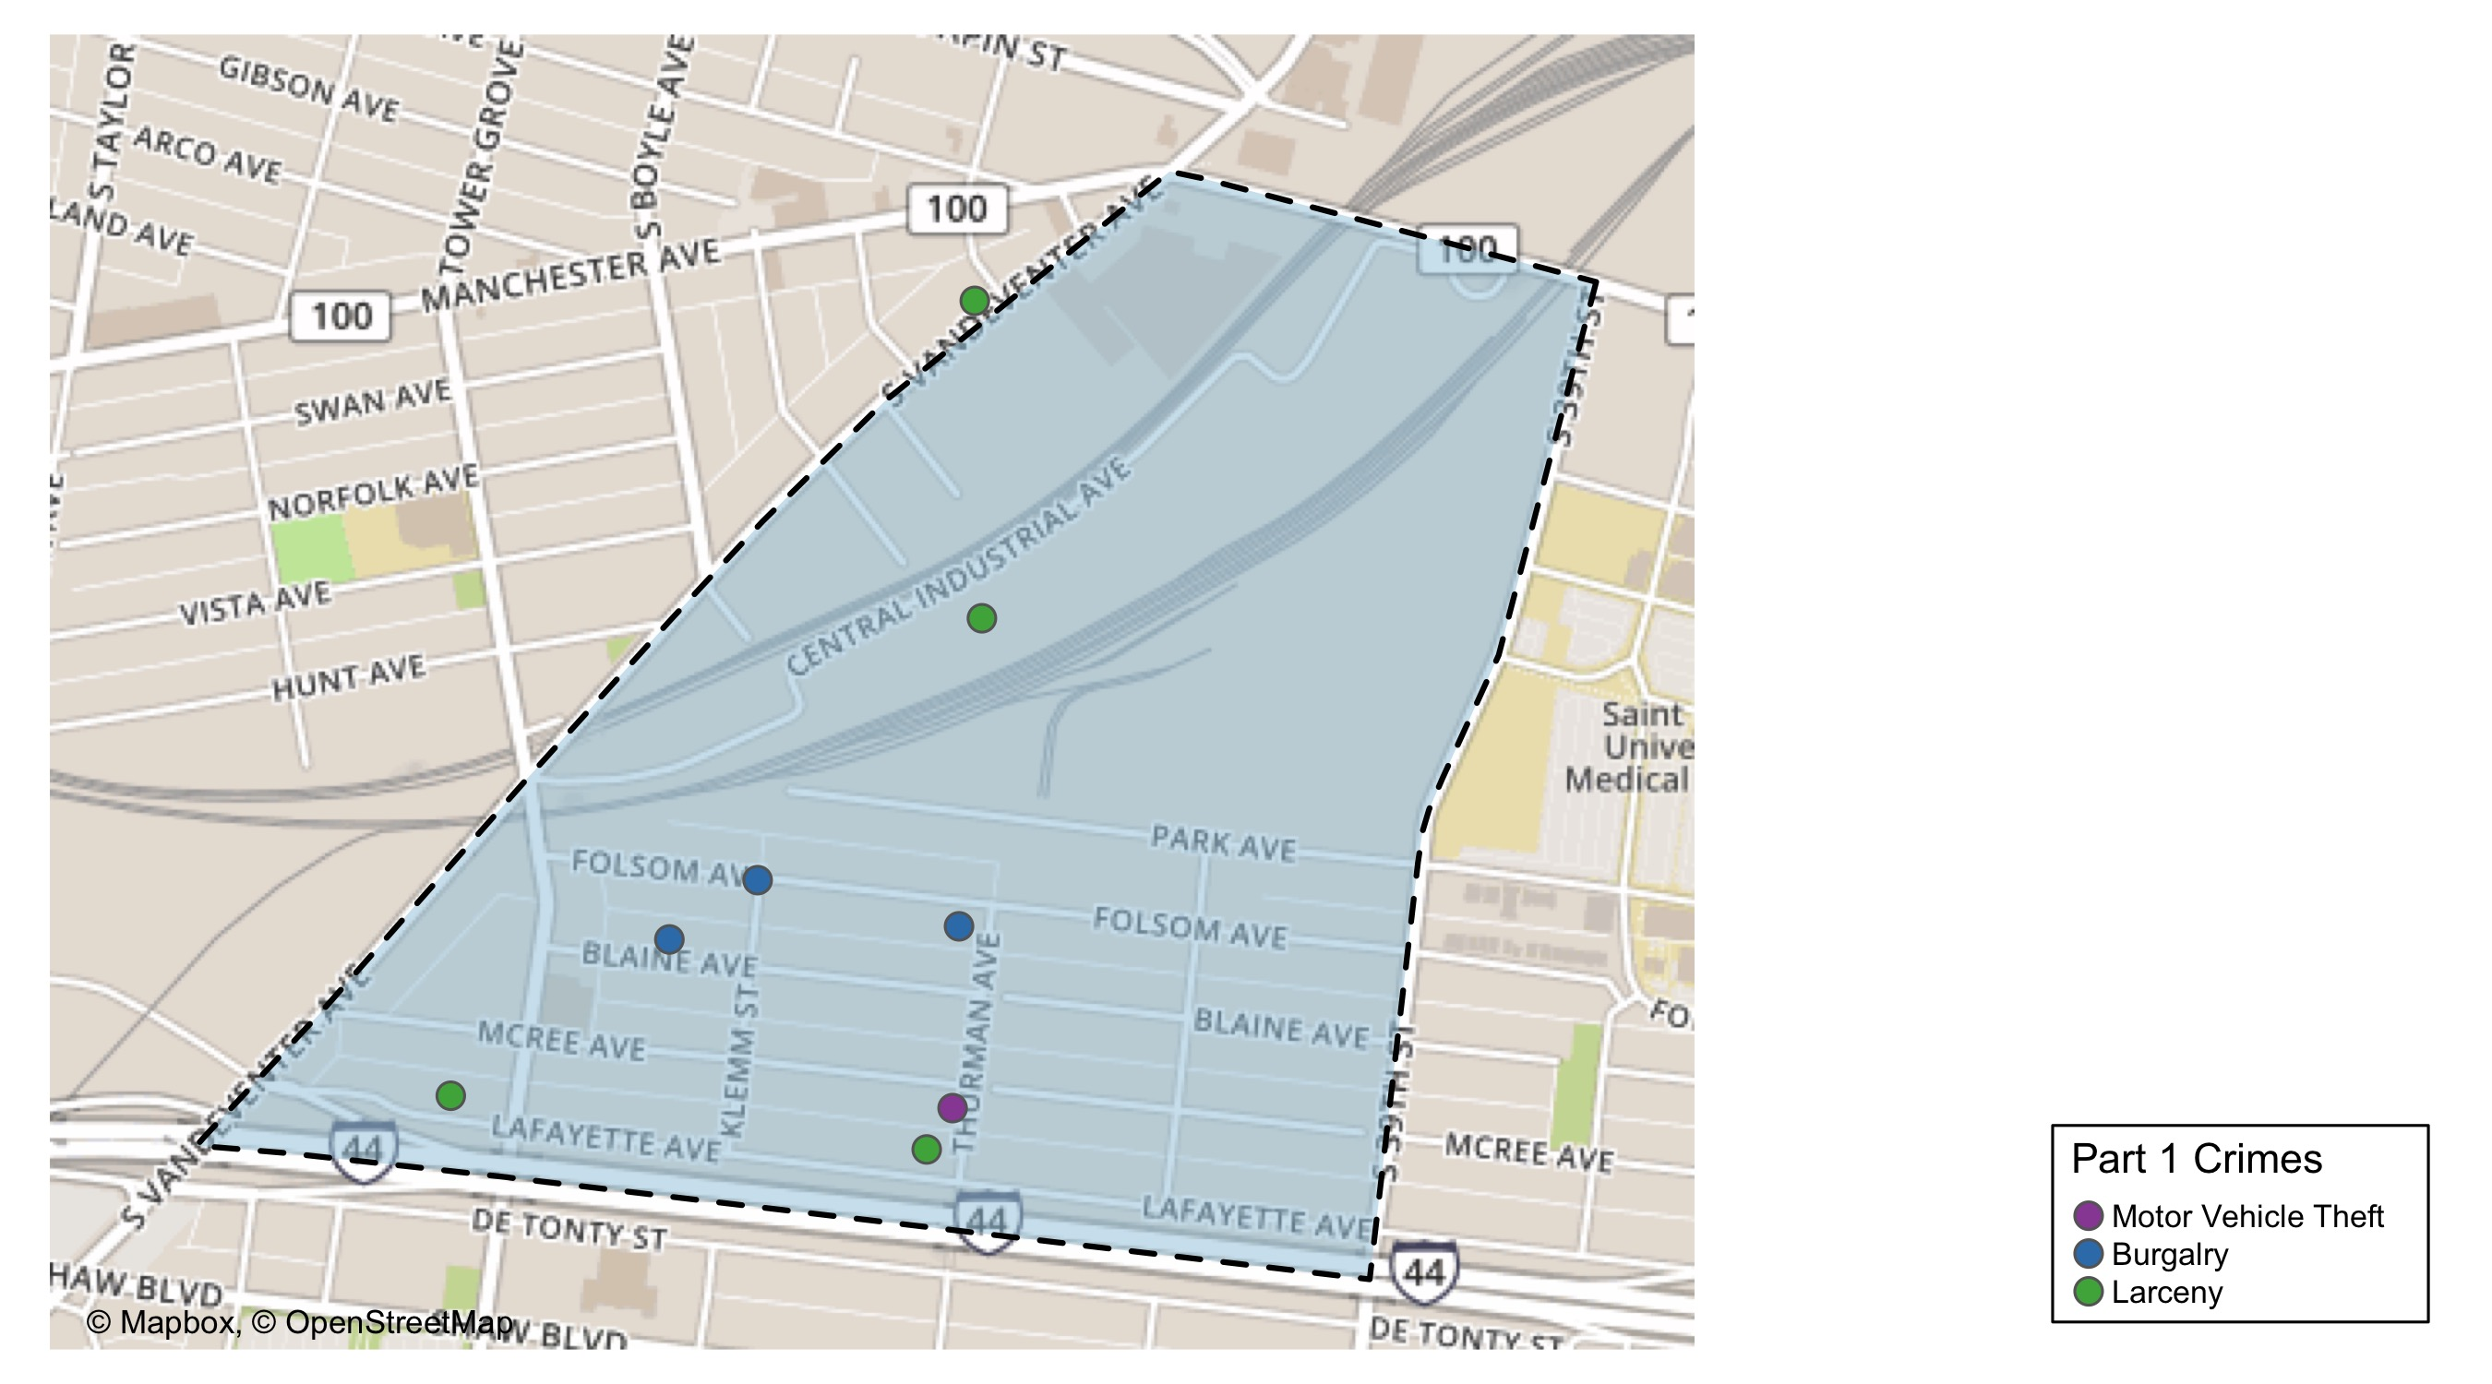
Botanical Heights: Total Crime Map

Slide 10
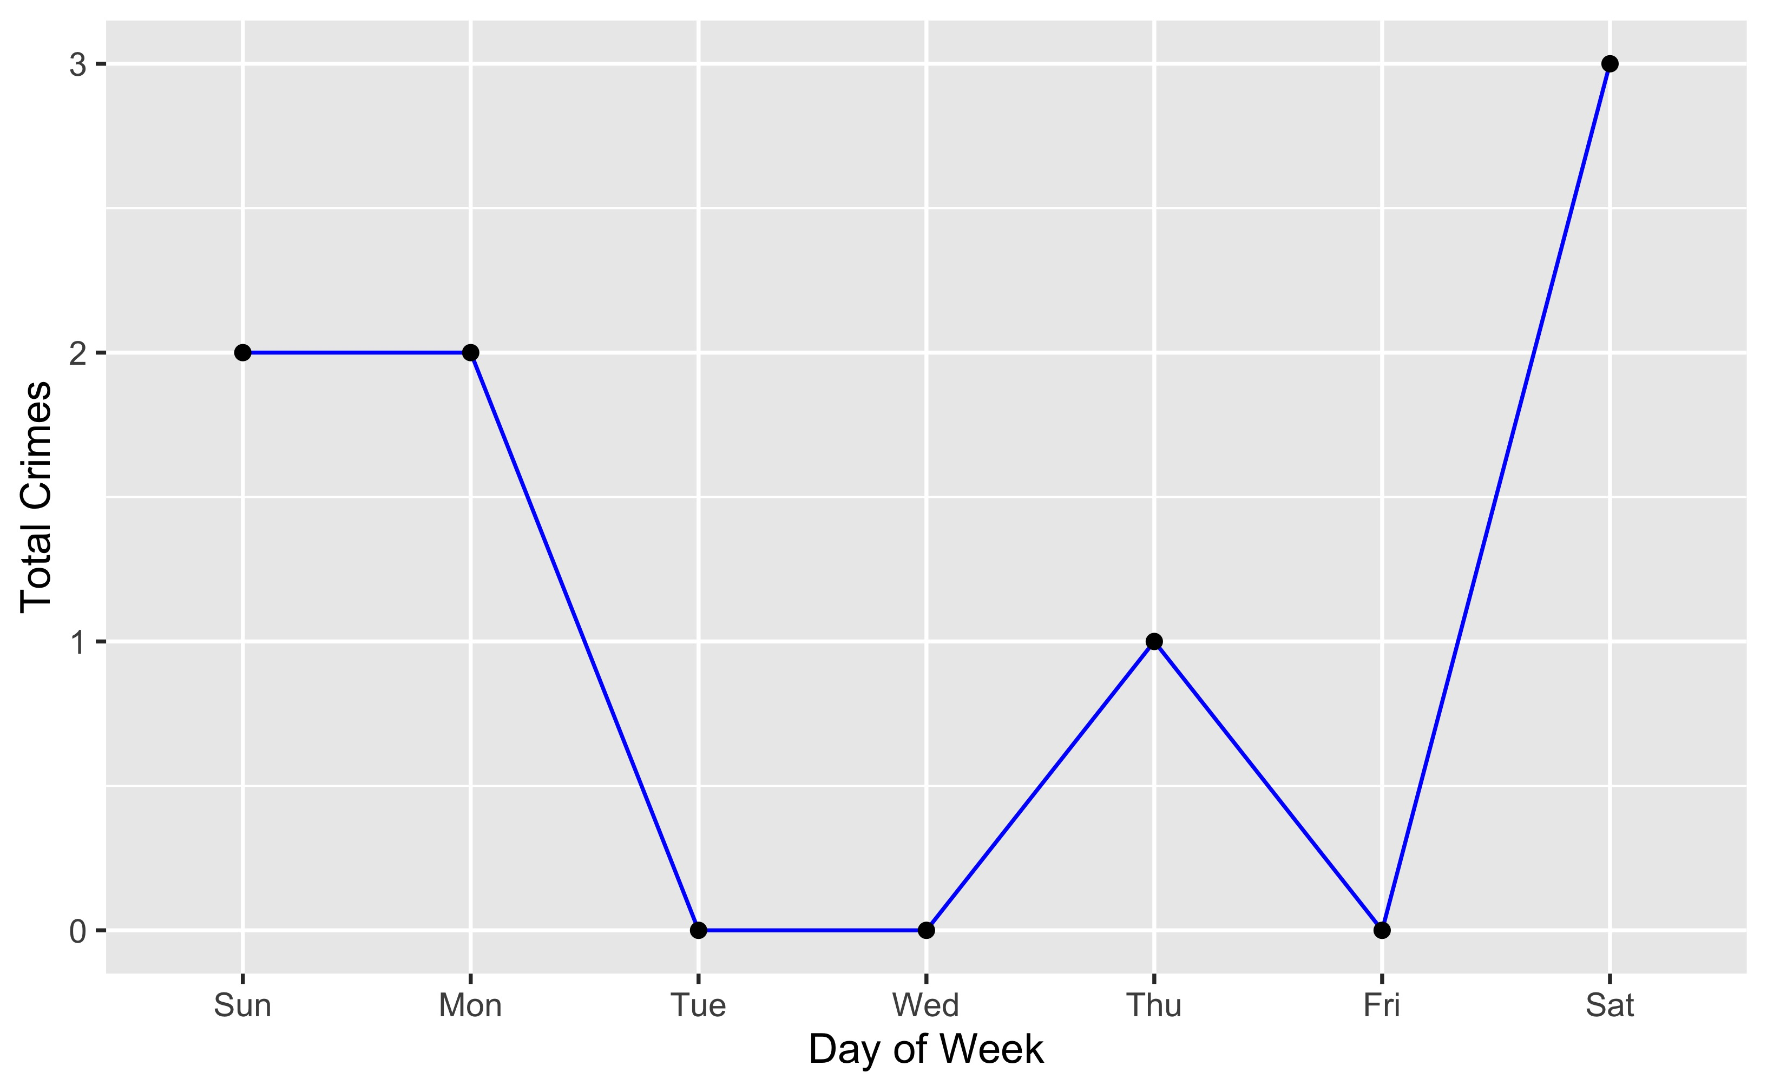
Botanical Heights: Crime by Days of the Week

Slide 11
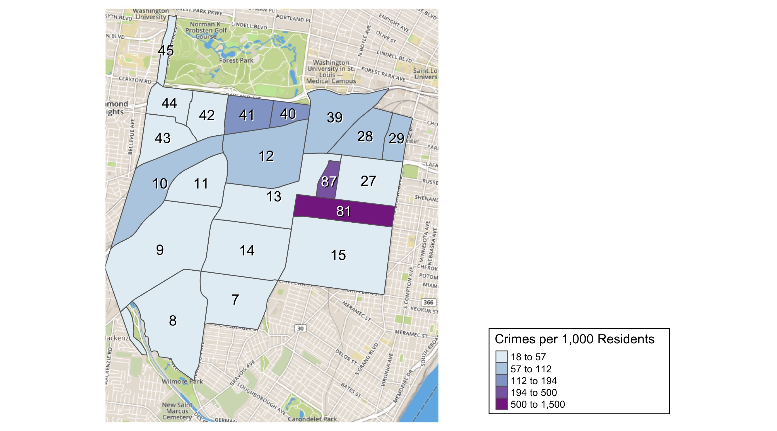
District 2: Crime Rates Map

Slide 12
District 2: Density Map Explanation
There are 23 neighborhoods in District 2. The South Hampton neighborhood is split between District 2 and District 1.
The minimum number of crimes in one neighborhood was 1 (Missouri Botanical Garden)
The maximum number of crimes in one neighborhood was 766 (Tower Grove South)
The mean number of crimes in one neighborhood was 176.81
The minimum rate of crimes in one neighborhood was 18.11 (Southampton)
The maximum rate of crimes in one neighborhood was 1500 (Tower Grove Park)
The mean rate of crimes in one neighborhood was 153.62

Slide 13
Central West End: Summary Notes
83 total crimes in December 2020
-17% change compared to December 2019 (100 total crimes)
7 crime(s) against persons in December 2020
-67% change compared to December 2019 (21 crimes against persons)
1186 total crimes in 2020
-2% change compared to this time in 2019 (1208 total crimes)
156 crime(s) against persons in 2020
-2% change compared to this time in 2019 (159 crimes against persons)

Slide 14
Central West End: Year to Year Comparison
2019 | 2019 | 2019 | 2019 | 2019 | 2019 | 2019 | 2019 | 2019 | 2019 | 2019 | 2019 | 2019 | 2019
Part 1 Crimes | Jan | Feb | Mar | Apr | May | Jun | Jul | Aug | Sep | Oct | Nov | Dec | Total
Aggravated Assault | 9 | 4 | 10 | 2 | 8 | 13 | 4 | 11 | 3 | 8 | 4 | 11 | 87
Arson | 0 | 0 | 1 | 0 | 0 | 0 | 0 | 0 | 0 | 0 | 0 | 0 | 1
Burgalry | 3 | 5 | 5 | 9 | 13 | 8 | 13 | 18 | 8 | 8 | 10 | 5 | 105
Homicide | 0 | 0 | 0 | 0 | 0 | 0 | 0 | 0 | 0 | 0 | 0 | 0 | 0
Larceny | 45 | 66 | 65 | 65 | 72 | 56 | 75 | 81 | 63 | 90 | 89 | 65 | 832
Motor Vehicle Theft | 11 | 7 | 3 | 11 | 12 | 9 | 5 | 11 | 9 | 5 | 19 | 9 | 111
Rape | 0 | 0 | 0 | 0 | 0 | 0 | 0 | 0 | 0 | 0 | 0 | 0 | 0
Robbery | 5 | 5 | 2 | 6 | 7 | 3 | 4 | 8 | 3 | 8 | 11 | 10 | 72
Total | 73 | 87 | 86 | 93 | 112 | 89 | 101 | 129 | 86 | 119 | 133 | 100 | 1,208
2020 | 2020 | 2020 | 2020 | 2020 | 2020 | 2020 | 2020 | 2020 | 2020 | 2020 | 2020 | 2020 | 2020
Part 1 Crimes | Jan | Feb | Mar | Apr | May | Jun | Jul | Aug | Sep | Oct | Nov | Dec | Total
Aggravated Assault | 3 | 5 | 6 | 10 | 8 | 10 | 12 | 12 | 7 | 6 | 7 | 3 | 89.0
Arson | 0 | 0 | 0 | 0 | 0 | 0 | 0 | 0 | 0 | 0 | 0 | 0 | 0.0
Burgalry | 7 | 5 | 4 | 8 | 7 | 23 | 4 | 14 | 10 | 16 | 7 | 9 | 114.0
Homicide | 1 | 0 | 0 | 0 | 1 | 0 | 0 | 0 | 0 | 0 | 0 | 0 | 2.0
Larceny | 53 | 54 | 55 | 64 | 77 | 98 | 63 | 64 | 80 | 72 | 54 | 59 | 793.0
Motor Vehicle Theft | 5 | 7 | 10 | 16 | 9 | 14 | 12 | 9 | 9 | 9 | 9 | 8 | 117.0
Rape | 0 | 2 | 1 | 0 | 0 | 0 | 0 | 0 | 0 | 0 | 1 | 0 | 4.0
Robbery | 12 | 8 | 5 | 2 | 4 | 7 | 5 | 1 | 9 | 7 | 3 | 4 | 67.0
Total | 81 | 81 | 81 | 100 | 106 | 152 | 96 | 100 | 115 | 110 | 81 | 83 | 1,186.0

Slide 15
Central West End: Summary Tables
Day of the Week | Number of Crimes
Sun | 13
Mon | 12
Tue | 9
Wed | 14
Thu | 15
Fri | 8
Sat | 12
Total | 83
Part 1 Crimes | Number of Crimes
Aggravated Assault | 3
Burgalry | 9
Larceny | 59
Motor Vehicle Theft | 8
Robbery | 4
Total | 83
Crimes Against Persons | Number of Crimes
FALSE | 76
TRUE | 7
Total | 83
Time of Day | Number of Crimes
Day | 77
Night | 6
Total | 83

Slide 16
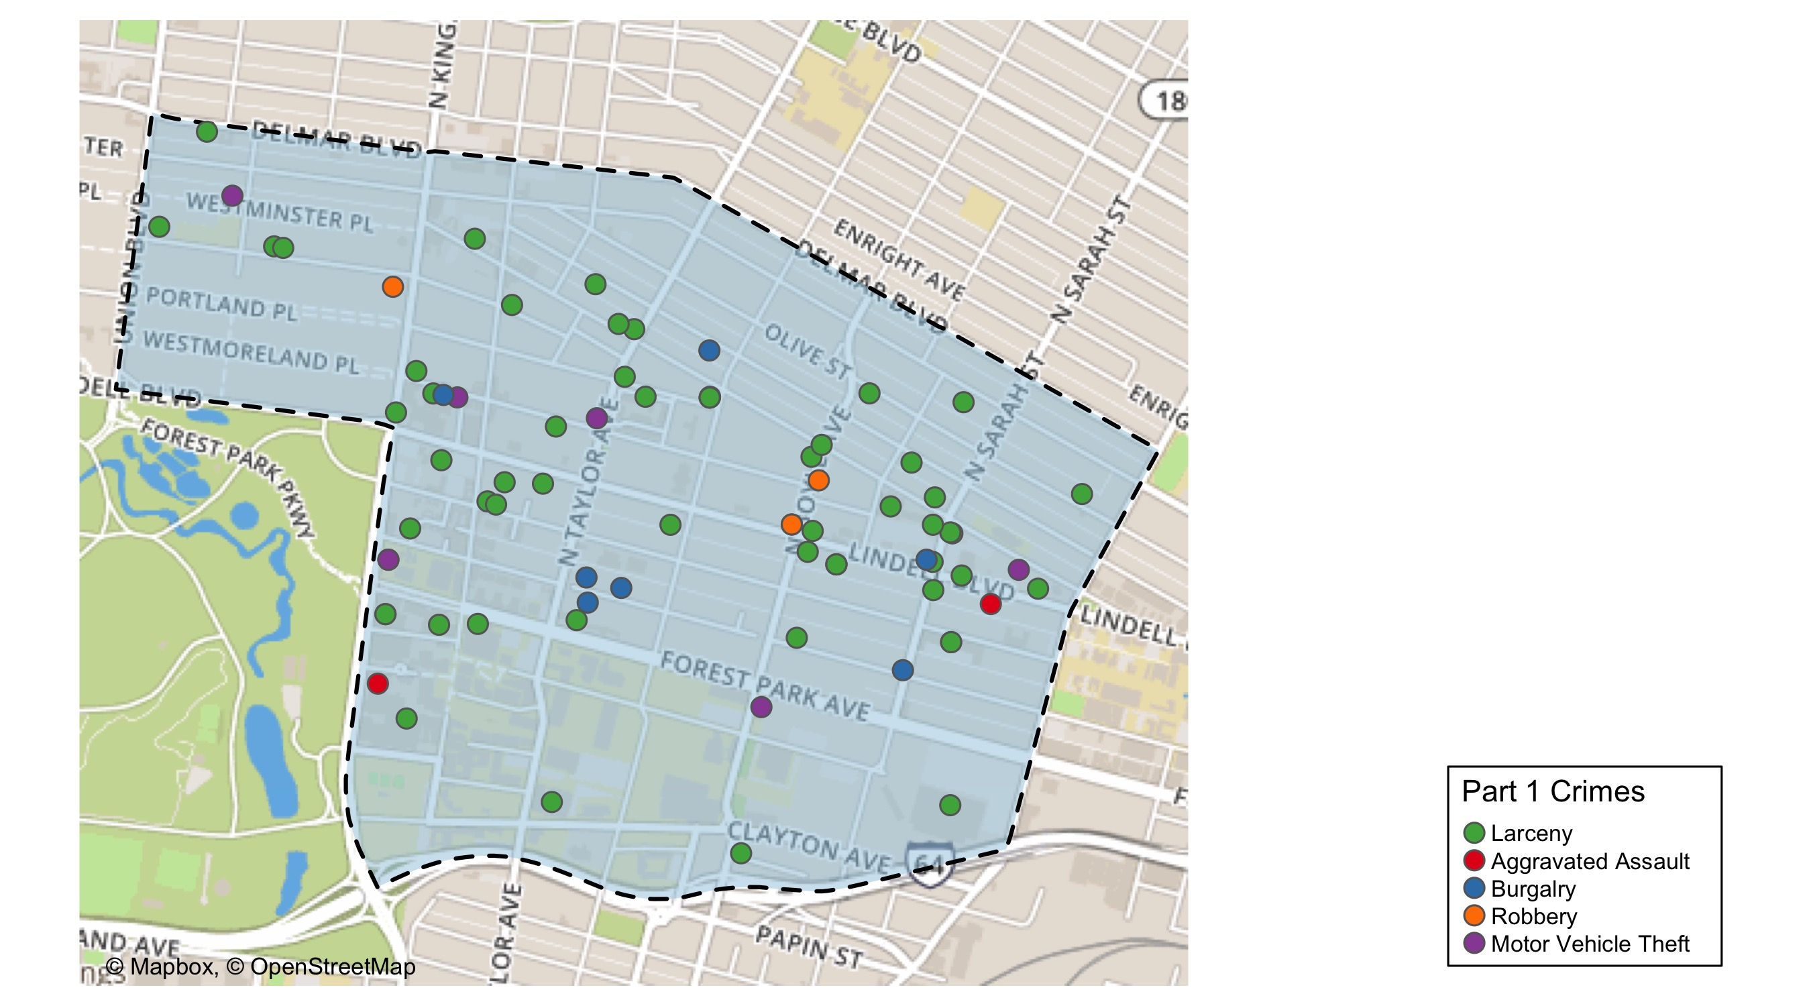
Central West End: Total Crime Map

Slide 17
Washington University Medical Campus: Summary Notes
7 total crimes in December 2020
-42% change compared to December 2019 (12 total crimes)
1 crime(s) against persons in December 2020
Infinite change compared to December 2019 (0 crimes against persons)
118 total crimes in 2020
-12% change compared to this time in 2019 (134 total crimes)
19 crime(s) against persons in 2020
-21% change compared to this time in 2019 (24 crimes against persons)

Slide 18
Washington University Medical Campus: Year to Year Comparison
2019 | 2019 | 2019 | 2019 | 2019 | 2019 | 2019 | 2019 | 2019 | 2019 | 2019 | 2019 | 2019 | 2019
Part 1 Crimes | Jan | Feb | Mar | Apr | May | Jun | Jul | Aug | Sep | Oct | Nov | Dec | Total
Aggravated Assault | 4 | 1 | 1 | 0 | 0 | 2 | 0 | 5 | 3 | 0 | 1 | 0 | 17
Arson | 0 | 0 | 0 | 0 | 0 | 0 | 0 | 0 | 0 | 0 | 0 | 0 | 0
Burgalry | 0 | 0 | 0 | 0 | 0 | 0 | 0 | 1 | 0 | 0 | 0 | 0 | 1
Homicide | 0 | 0 | 0 | 0 | 0 | 0 | 0 | 0 | 0 | 0 | 0 | 0 | 0
Larceny | 7 | 8 | 6 | 9 | 9 | 6 | 8 | 4 | 11 | 6 | 10 | 10 | 94
Motor Vehicle Theft | 2 | 0 | 1 | 2 | 1 | 0 | 0 | 1 | 2 | 0 | 4 | 2 | 15
Rape | 0 | 0 | 0 | 0 | 0 | 0 | 0 | 0 | 0 | 0 | 0 | 0 | 0
Robbery | 0 | 0 | 0 | 1 | 0 | 1 | 0 | 1 | 1 | 1 | 2 | 0 | 7
Total | 13 | 9 | 8 | 12 | 10 | 9 | 8 | 12 | 17 | 7 | 17 | 12 | 134
2020 | 2020 | 2020 | 2020 | 2020 | 2020 | 2020 | 2020 | 2020 | 2020 | 2020 | 2020 | 2020 | 2020
Part 1 Crimes | Jan | Feb | Mar | Apr | May | Jun | Jul | Aug | Sep | Oct | Nov | Dec | Total
Aggravated Assault | 0 | 1 | 2 | 2 | 1 | 0 | 1 | 2 | 0 | 1 | 1 | 1 | 12.0
Arson | 0 | 0 | 0 | 0 | 0 | 0 | 0 | 0 | 0 | 0 | 0 | 0 | 0.0
Burgalry | 1 | 0 | 0 | 0 | 0 | 0 | 0 | 0 | 0 | 1 | 0 | 0 | 2.0
Homicide | 0 | 0 | 0 | 0 | 0 | 0 | 0 | 0 | 0 | 0 | 0 | 0 | 0.0
Larceny | 8 | 9 | 6 | 6 | 5 | 11 | 3 | 4 | 7 | 10 | 5 | 6 | 80.0
Motor Vehicle Theft | 0 | 2 | 0 | 1 | 0 | 2 | 0 | 4 | 3 | 2 | 1 | 0 | 15.0
Rape | 0 | 1 | 0 | 0 | 0 | 0 | 0 | 0 | 0 | 0 | 1 | 0 | 2.0
Robbery | 1 | 3 | 0 | 0 | 0 | 1 | 1 | 0 | 0 | 1 | 0 | 0 | 7.0
Total | 10 | 16 | 8 | 9 | 6 | 14 | 5 | 10 | 10 | 15 | 8 | 7 | 118.0

Slide 19
Washington University Medical Campus: Summary Tables
Part 1 Crimes | Number of Crimes
Aggravated Assault | 1
Larceny | 6
Total | 7
Type of Larceny | Number of Crimes
From Motor Vehicle | 1
Total | 1
Time of Day | Number of Crimes
Day | 7
Total | 7
Monetary Value | Number of Crimes
Under $500 | 1
Total | 1

Slide 20
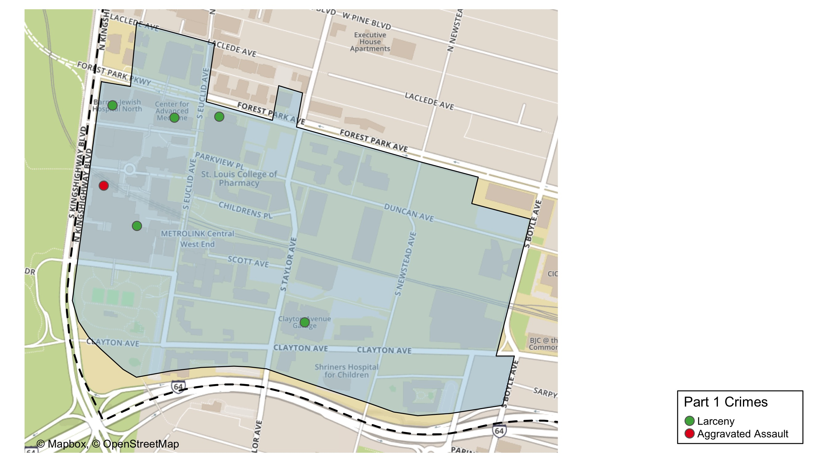
Washington University Medical Center: Total Crime Map

Slide 21
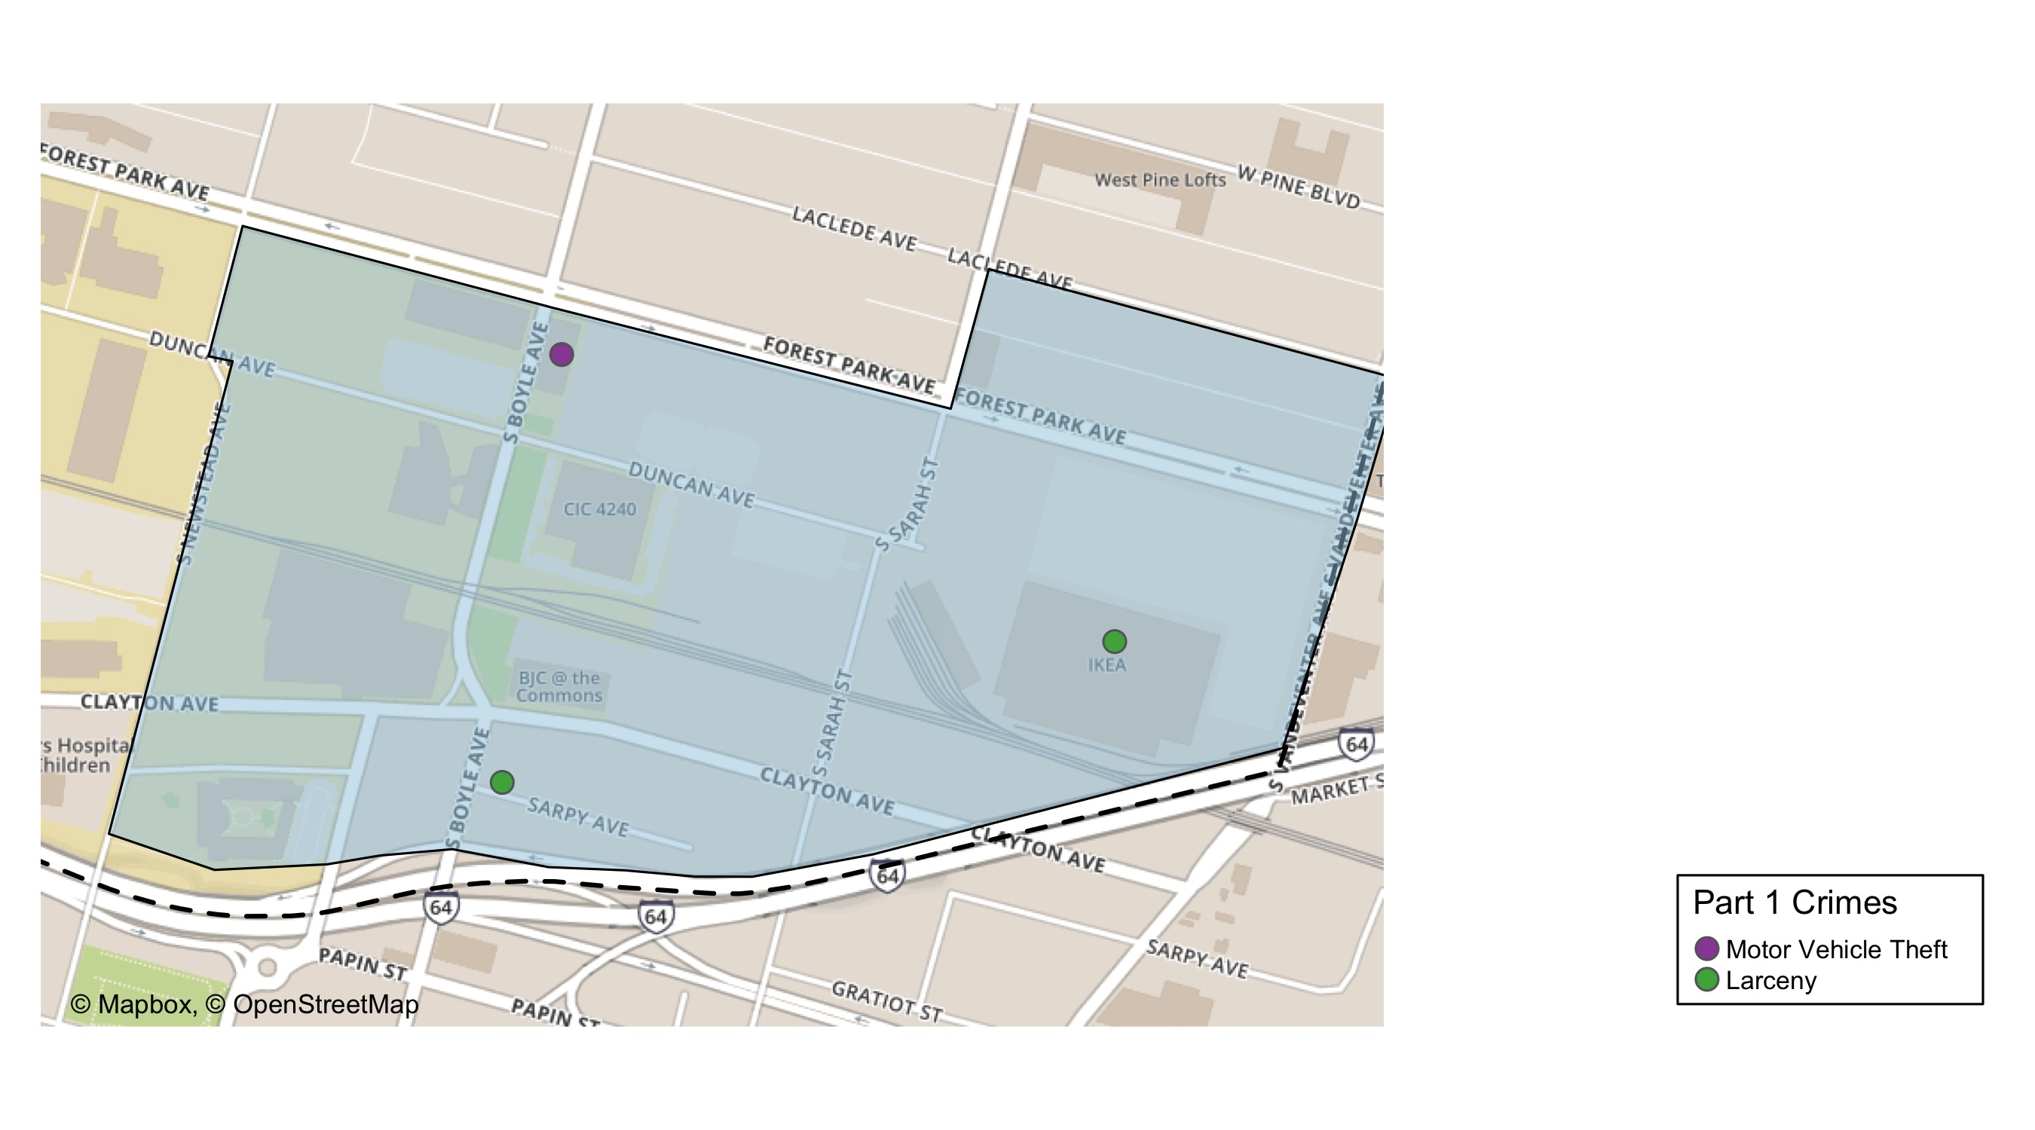
Cortex: Total Crime Map

Slide 22
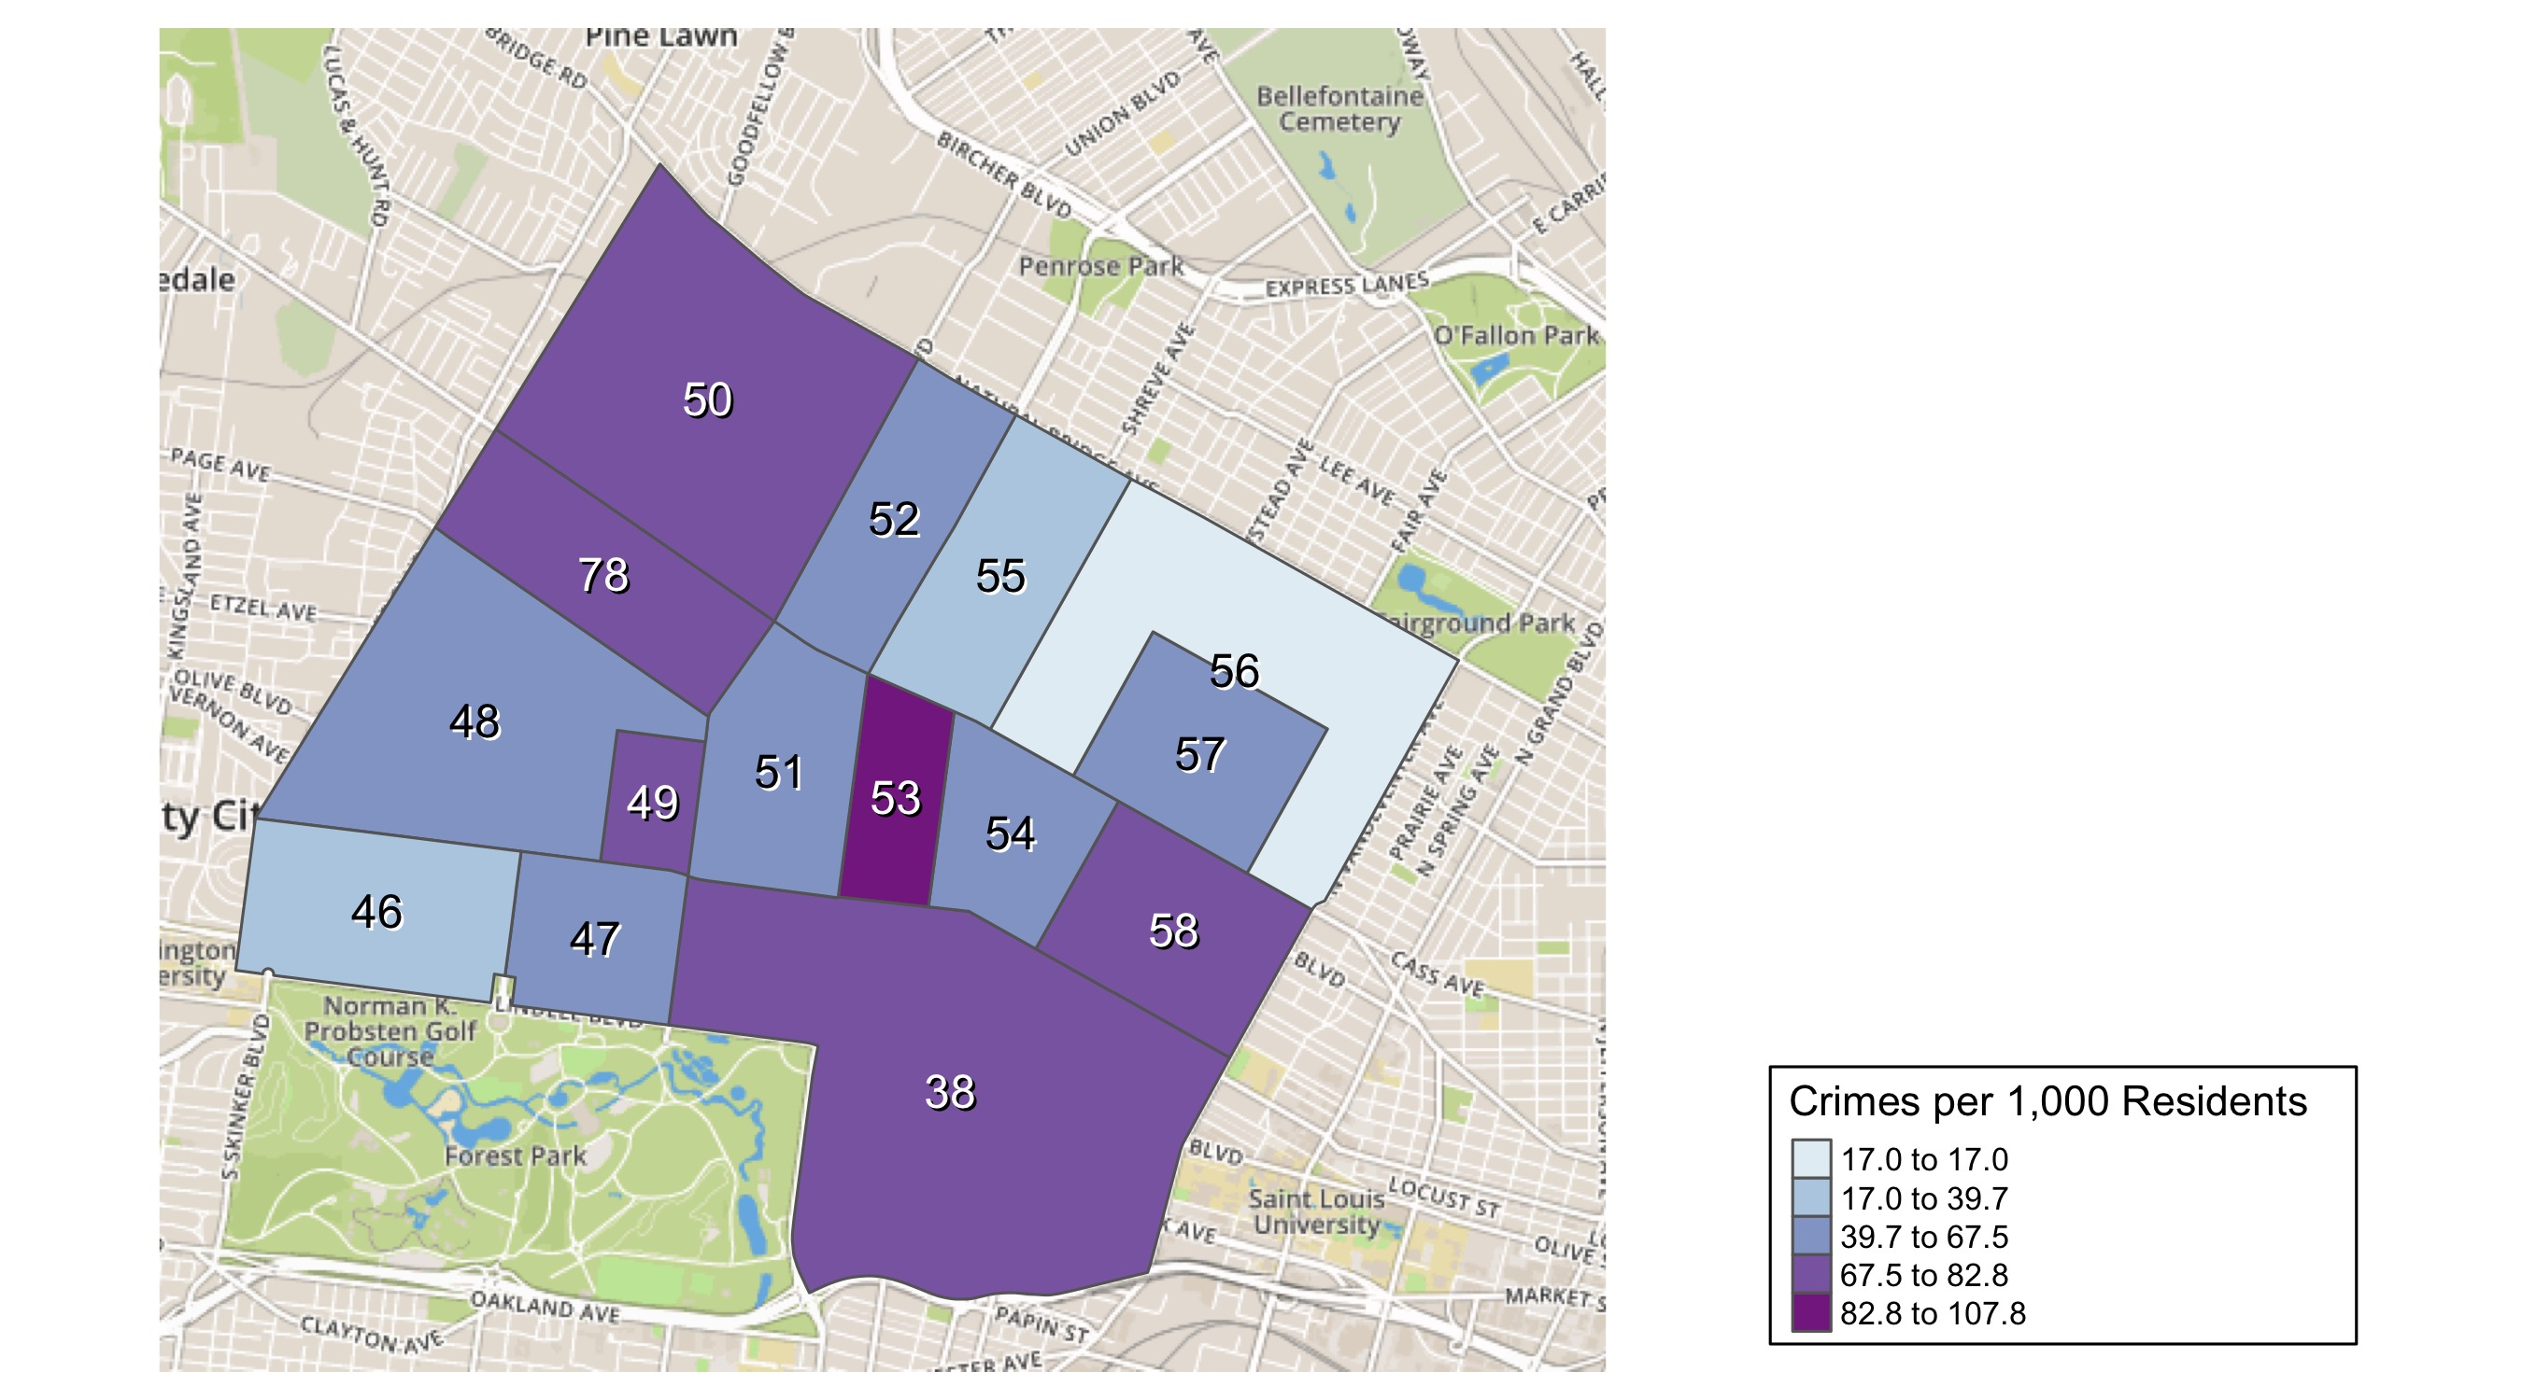
District 5: Crime Rates Map

Slide 23
District 5: Density Map Explanation
There are 15 neighborhoods in District 5
The minimum number of crimes in one neighborhood was 76 (Visitation Park)
The maximum number of crimes in one neighborhood was 1186 (Central West End)
The mean number of crimes in one neighborhood was 257.27
The minimum rate of crimes in one neighborhood was 16.97 (Greater Ville)
The maximum rate of crimes in one neighborhood was 107.82 (Fountain Park)
The mean rate of crimes in one neighborhood was 64.22

Slide 24
Forest Park Southeast: Neighborhood Detail
Appendix 1

Slide 25
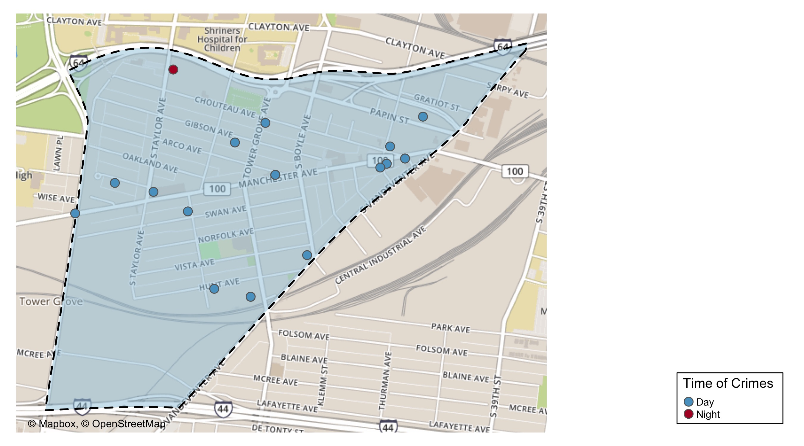
Forest Park Southeast: Time of Crimes Map

Slide 26
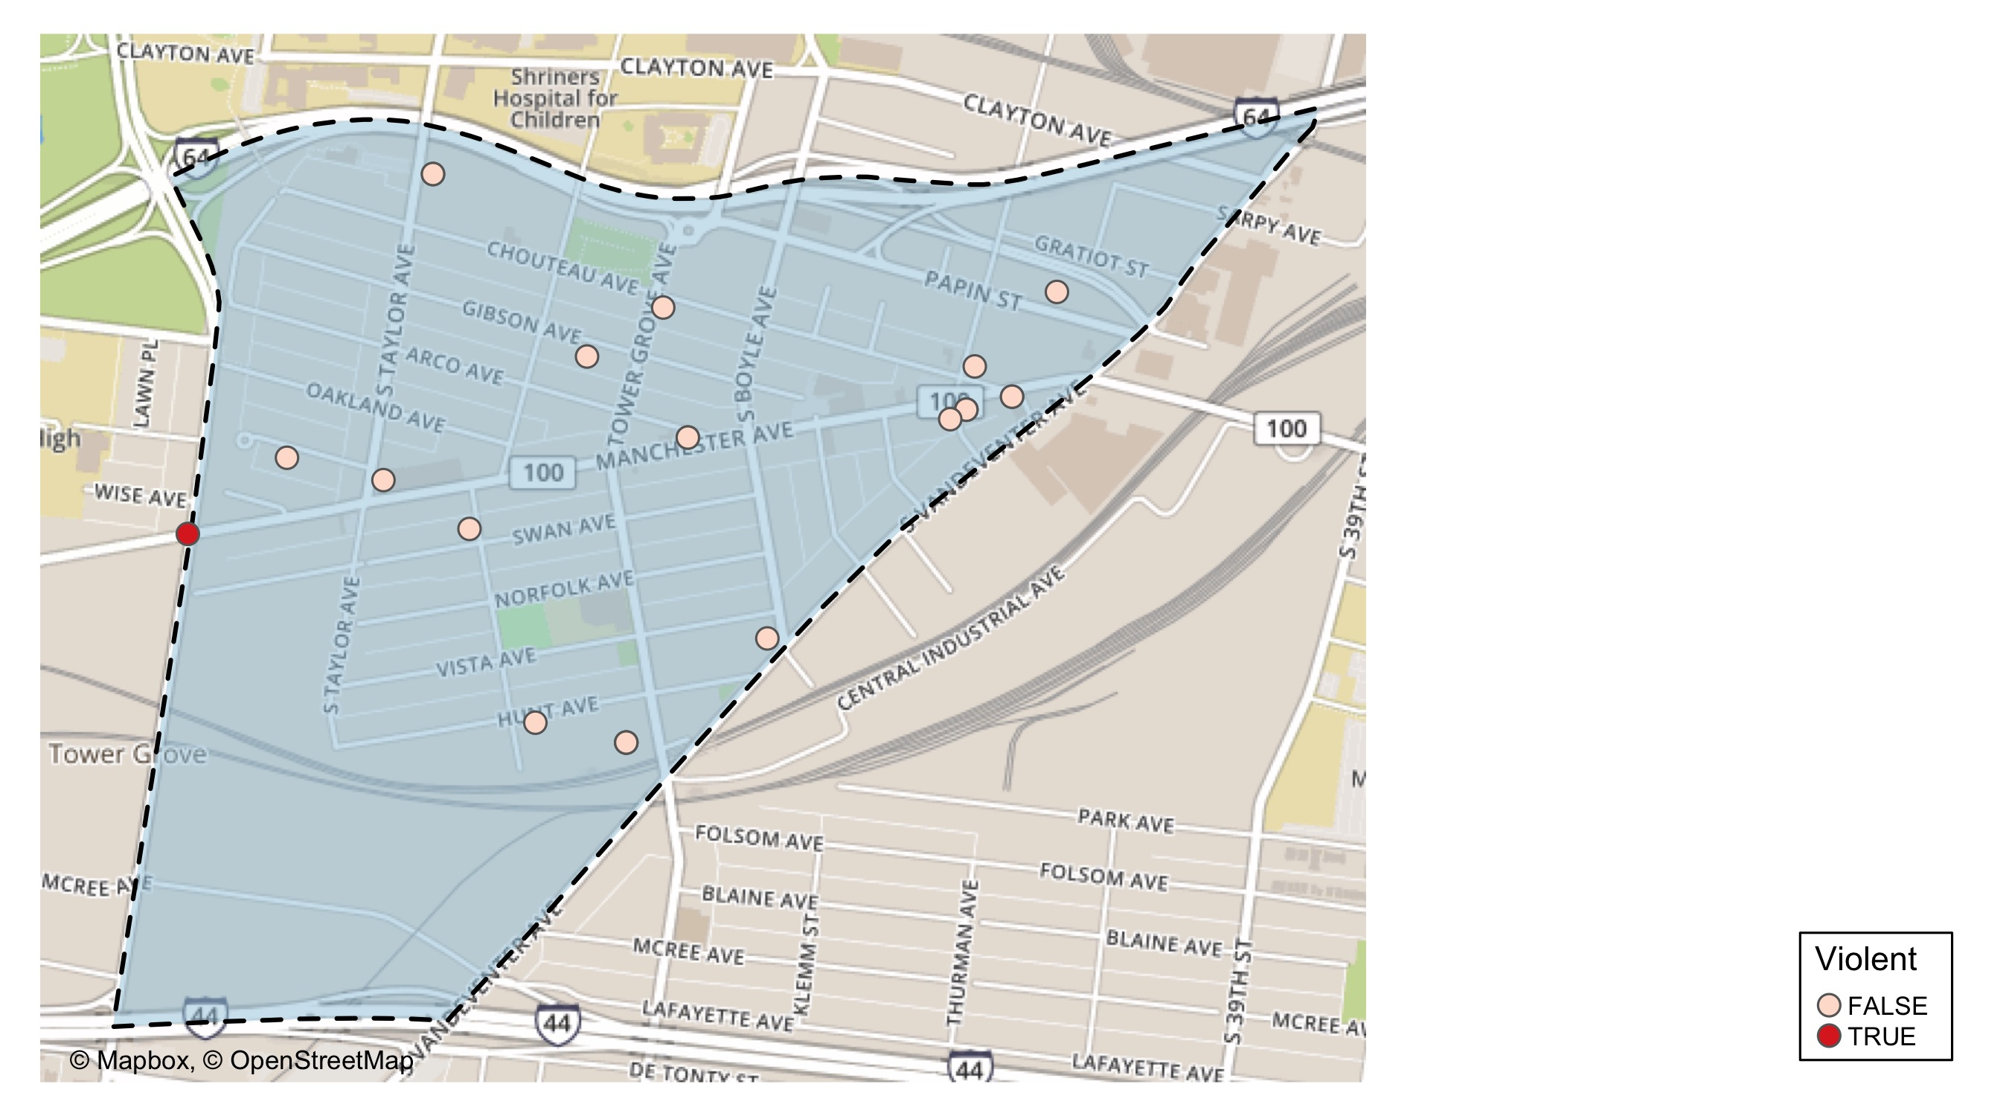
Forest Park Southeast: Violent Crime Map

Slide 27
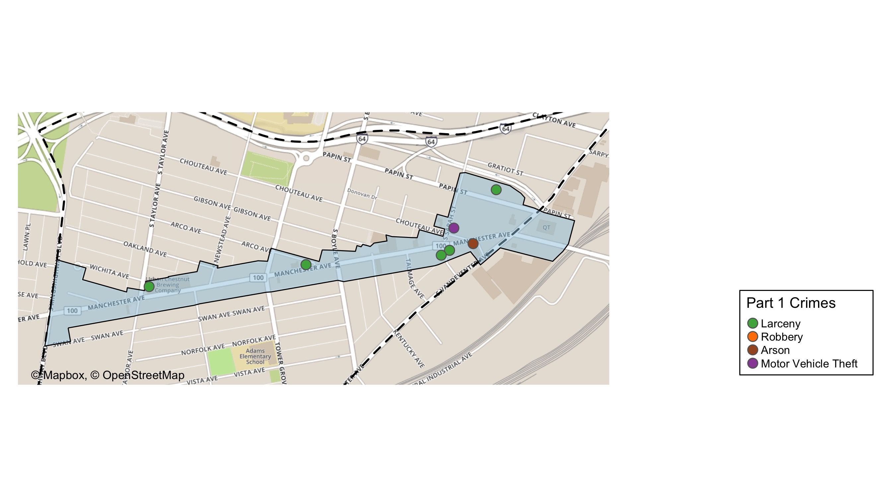
Grove Community Improvement District: Total Crime Map

Slide 28
Forest Park Southeast: Larceny Breakdown
Day of the Week | Number of Crimes
Sun | 3
Mon | 3
Tue | 3
Wed | 0
Thu | 1
Fri | 2
Sat | 4
Total | 16
Type of Larceny | Number of Crimes
All Other | 1
From Building | 1
From Motor Vehicle | 11
Motor Vehicle Parts | 3
Total | 16
Time of Day | Number of Crimes
Day | 15
Night | 1
Total | 16
Monetary | Number of Crimes
$500 - $24,999 | 4
Under $500 | 12
Total | 16

Slide 29
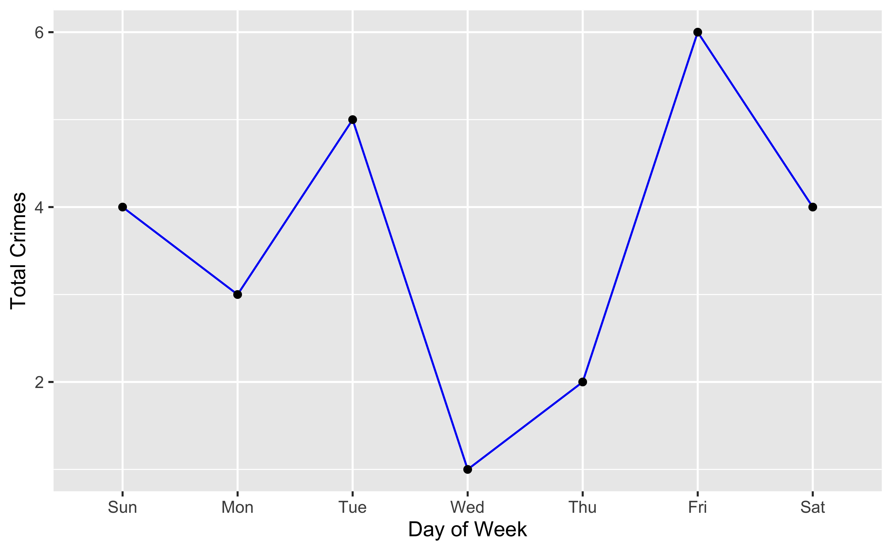
Forest Park Southeast: Total Crimes by Days of the Week

Slide 30
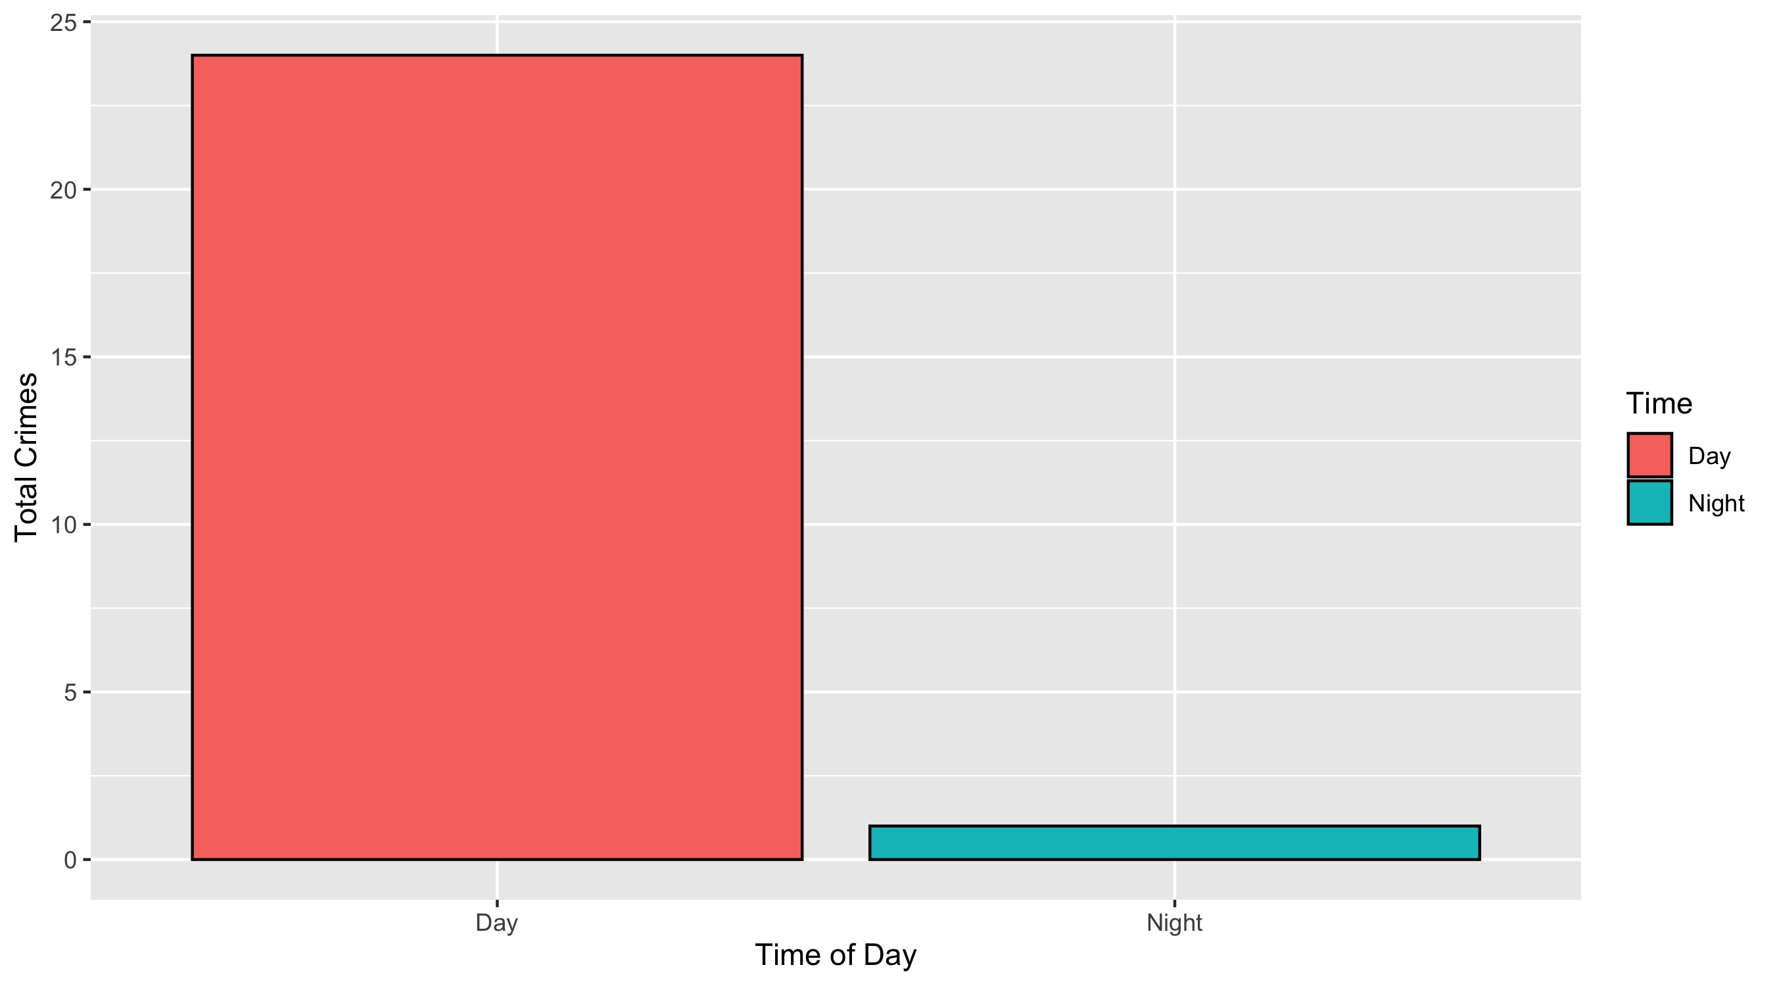
Forest Park Southeast: Crimes by Time of Day

Slide 31
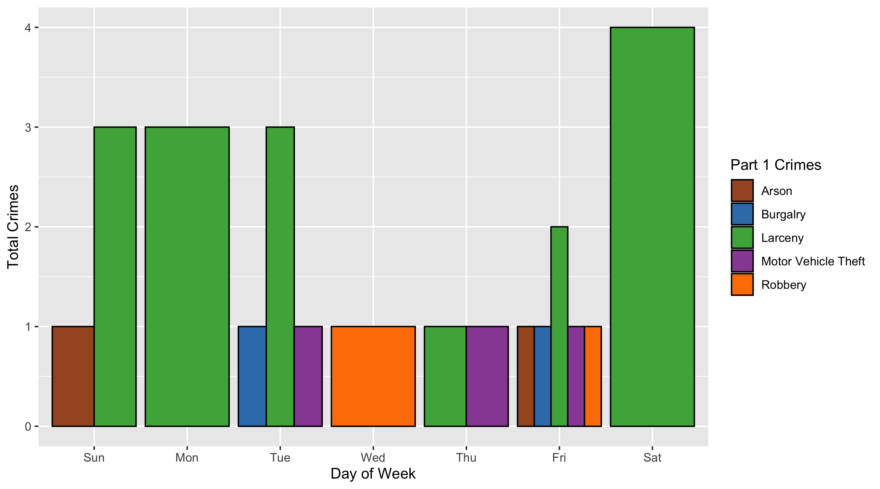
Forest Park Southeast: Crimes by Day & Category

Slide 32
Central West End: Neighborhood Detail
Appendix 2

Slide 33
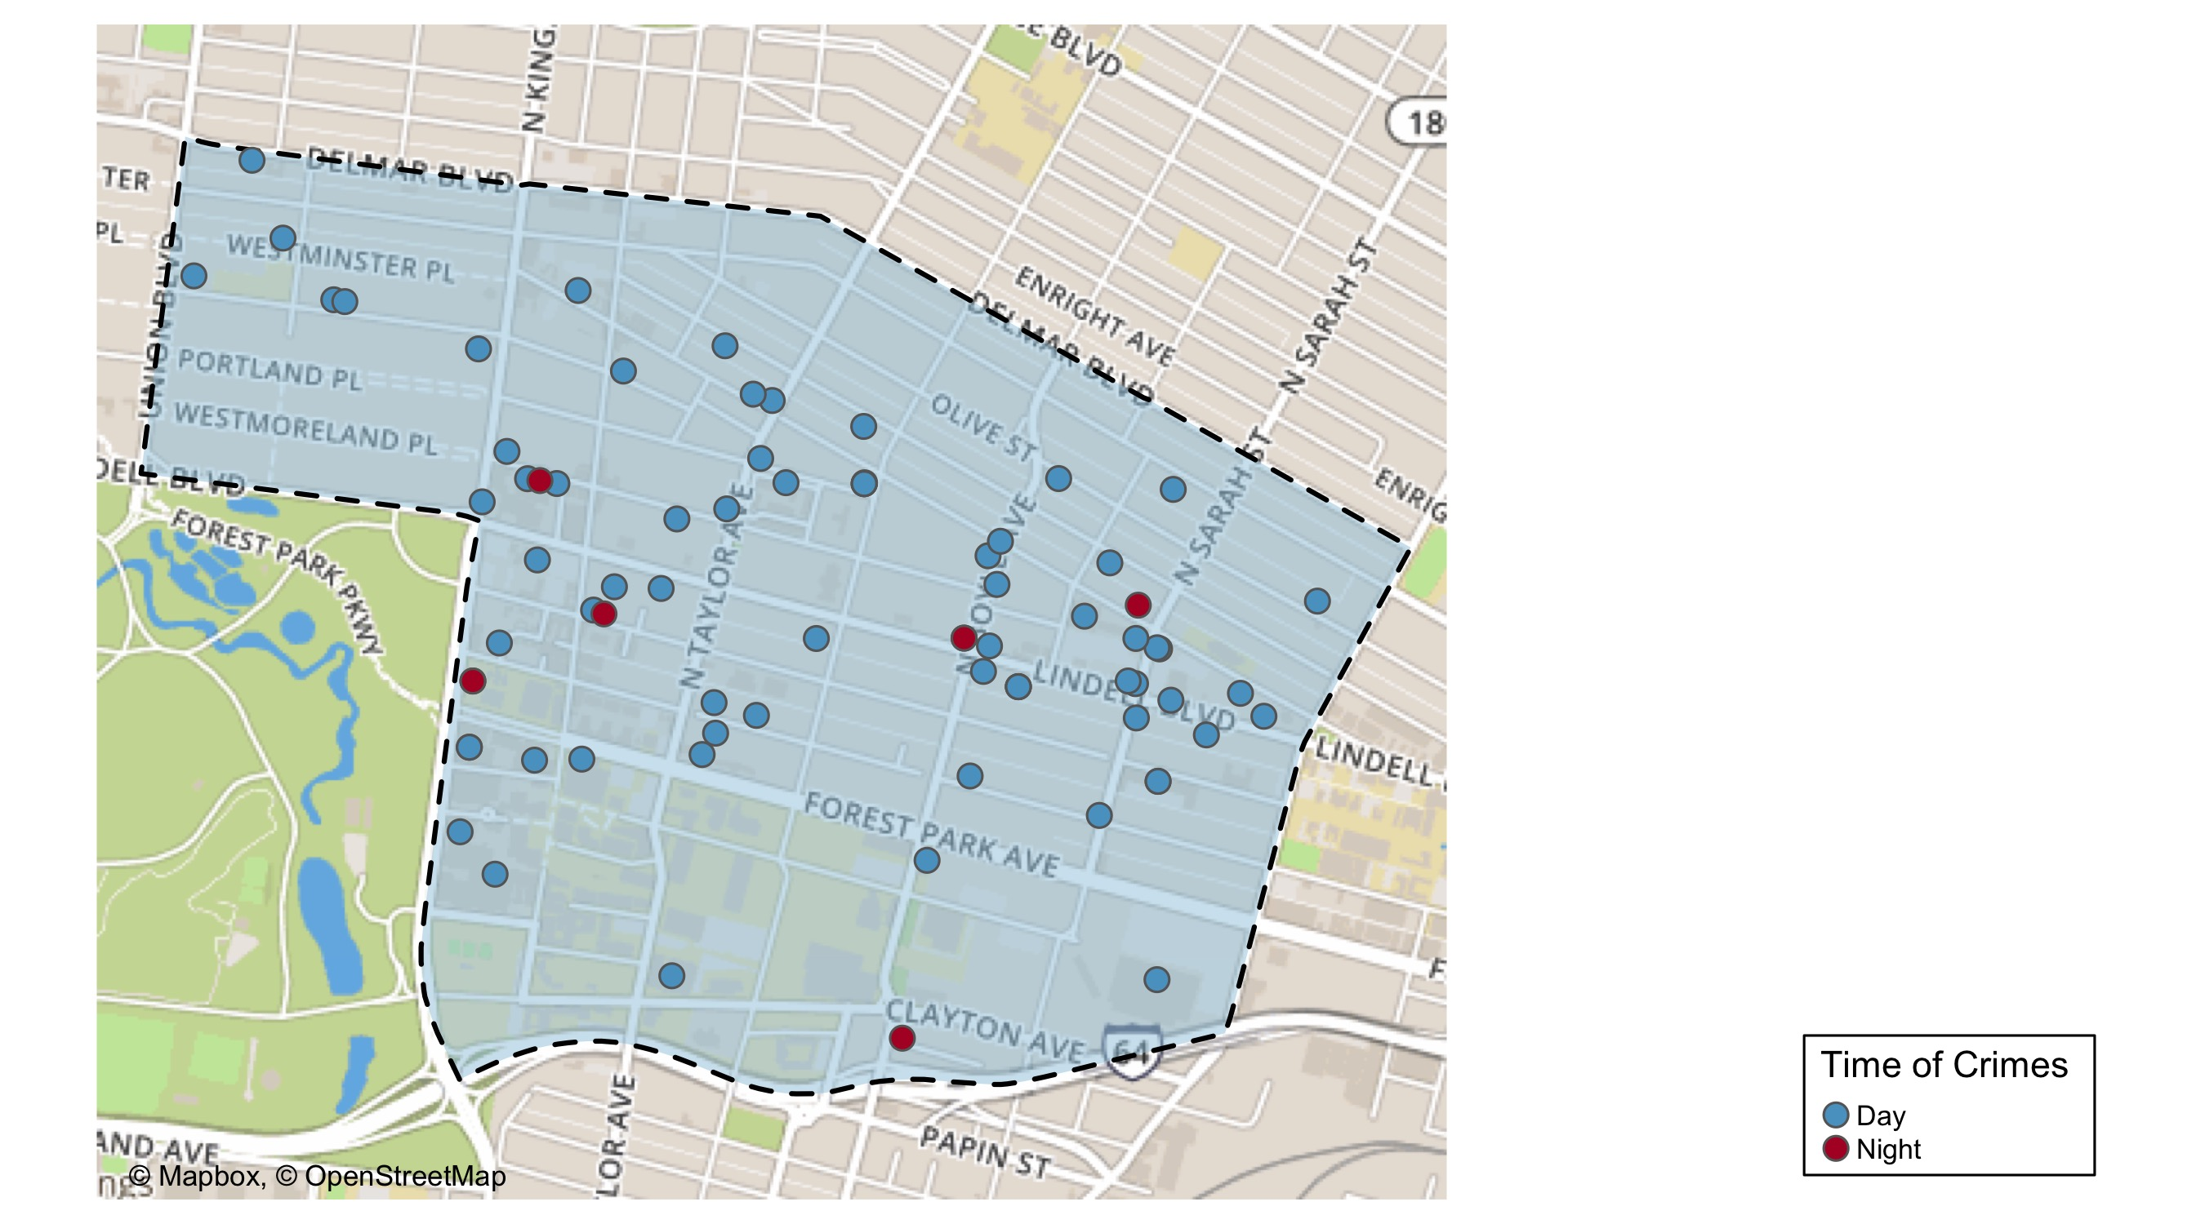
Central West End: Time of Crime Map

Slide 34
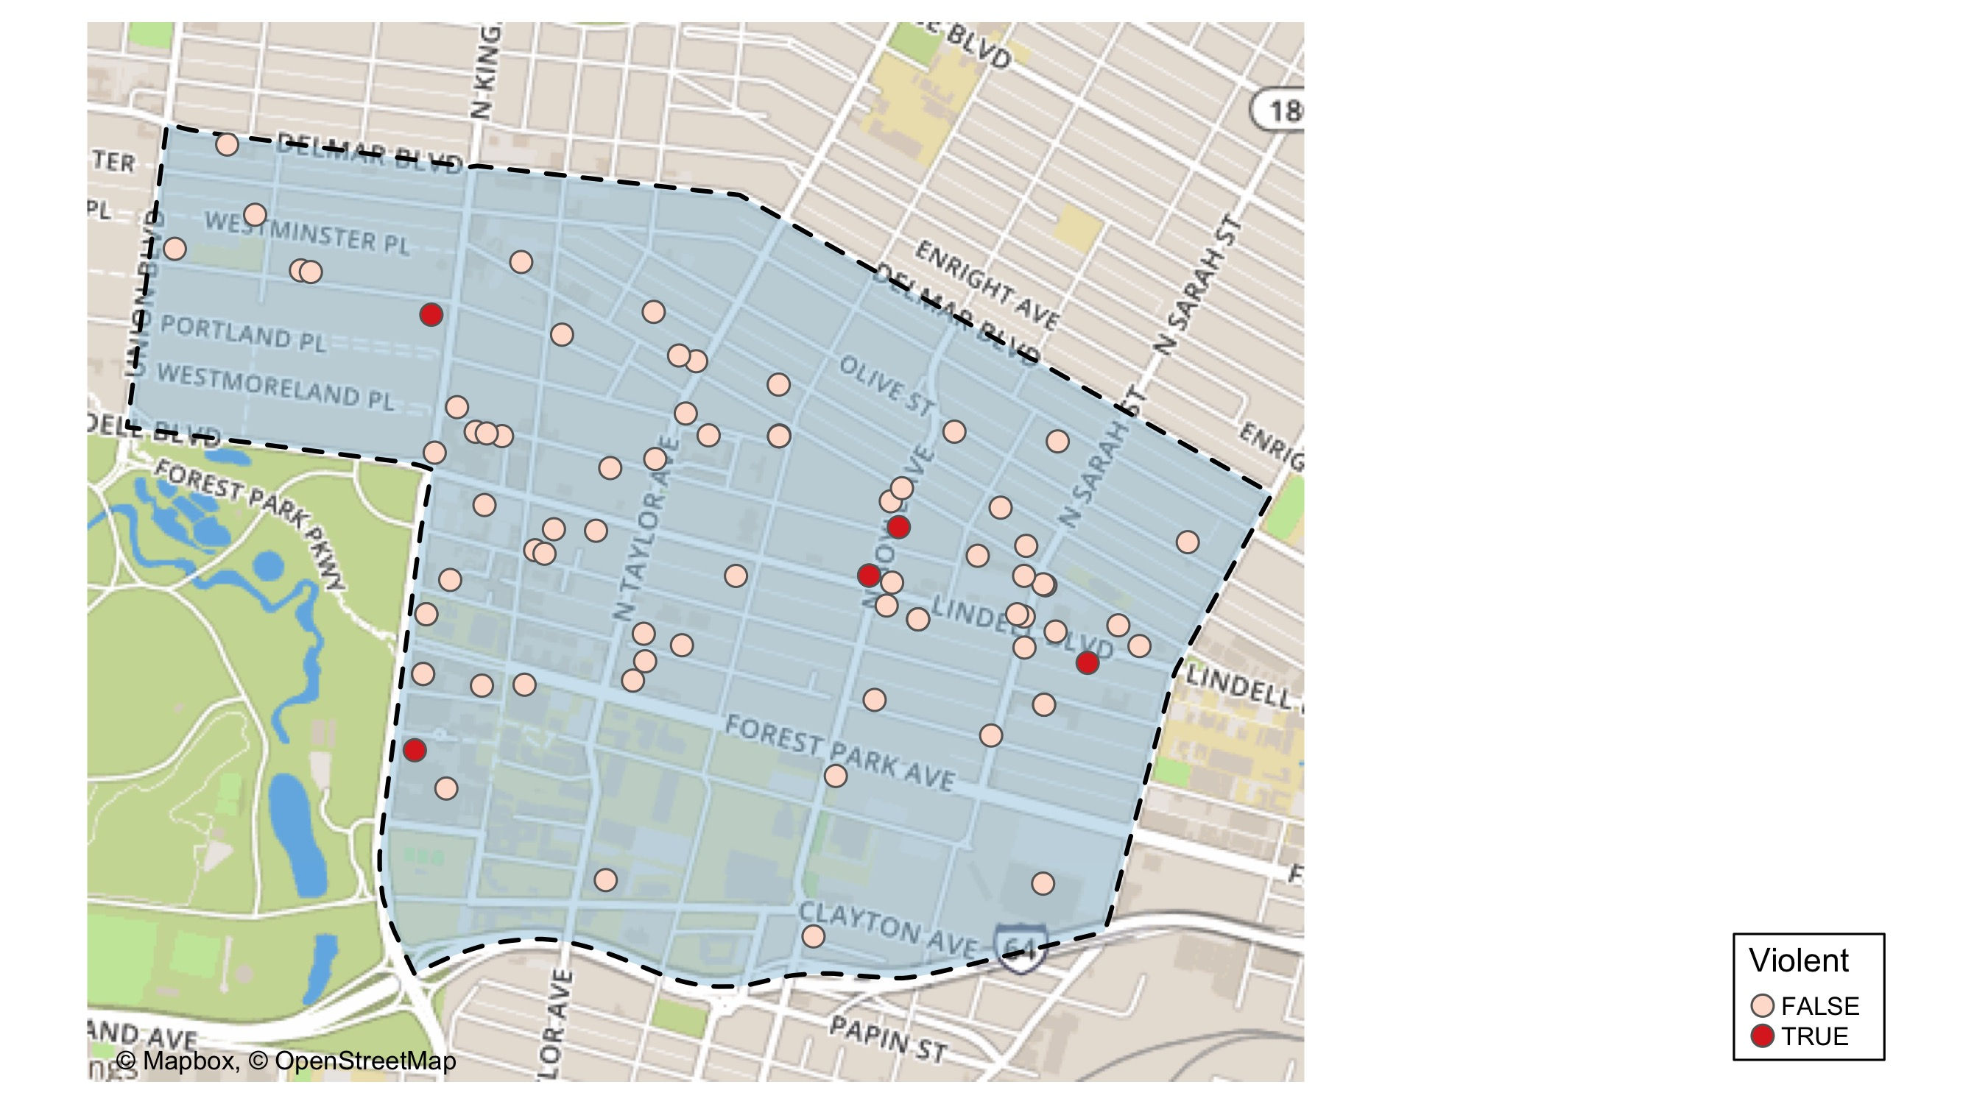
Central West End: Violent Crime Map

Slide 35
Central West End: Larceny Breakdown
Day of the Week | Number of Crimes
Sun | 7
Mon | 9
Tue | 6
Wed | 12
Thu | 13
Fri | 3
Sat | 9
Total | 59
Type of Larceny | Number of Crimes
All Other | 8
Bicycle | 1
From Building | 11
From Motor Vehicle | 18
Motor Vehicle Parts | 14
Shoplifting | 7
Total | 59
Time of Day | Number of Crimes
Day | 56
Night | 3
Total | 59
Monetary Value | Number of Crimes
$500 - $24,999 | 12
Under $500 | 47
Total | 59

Slide 36
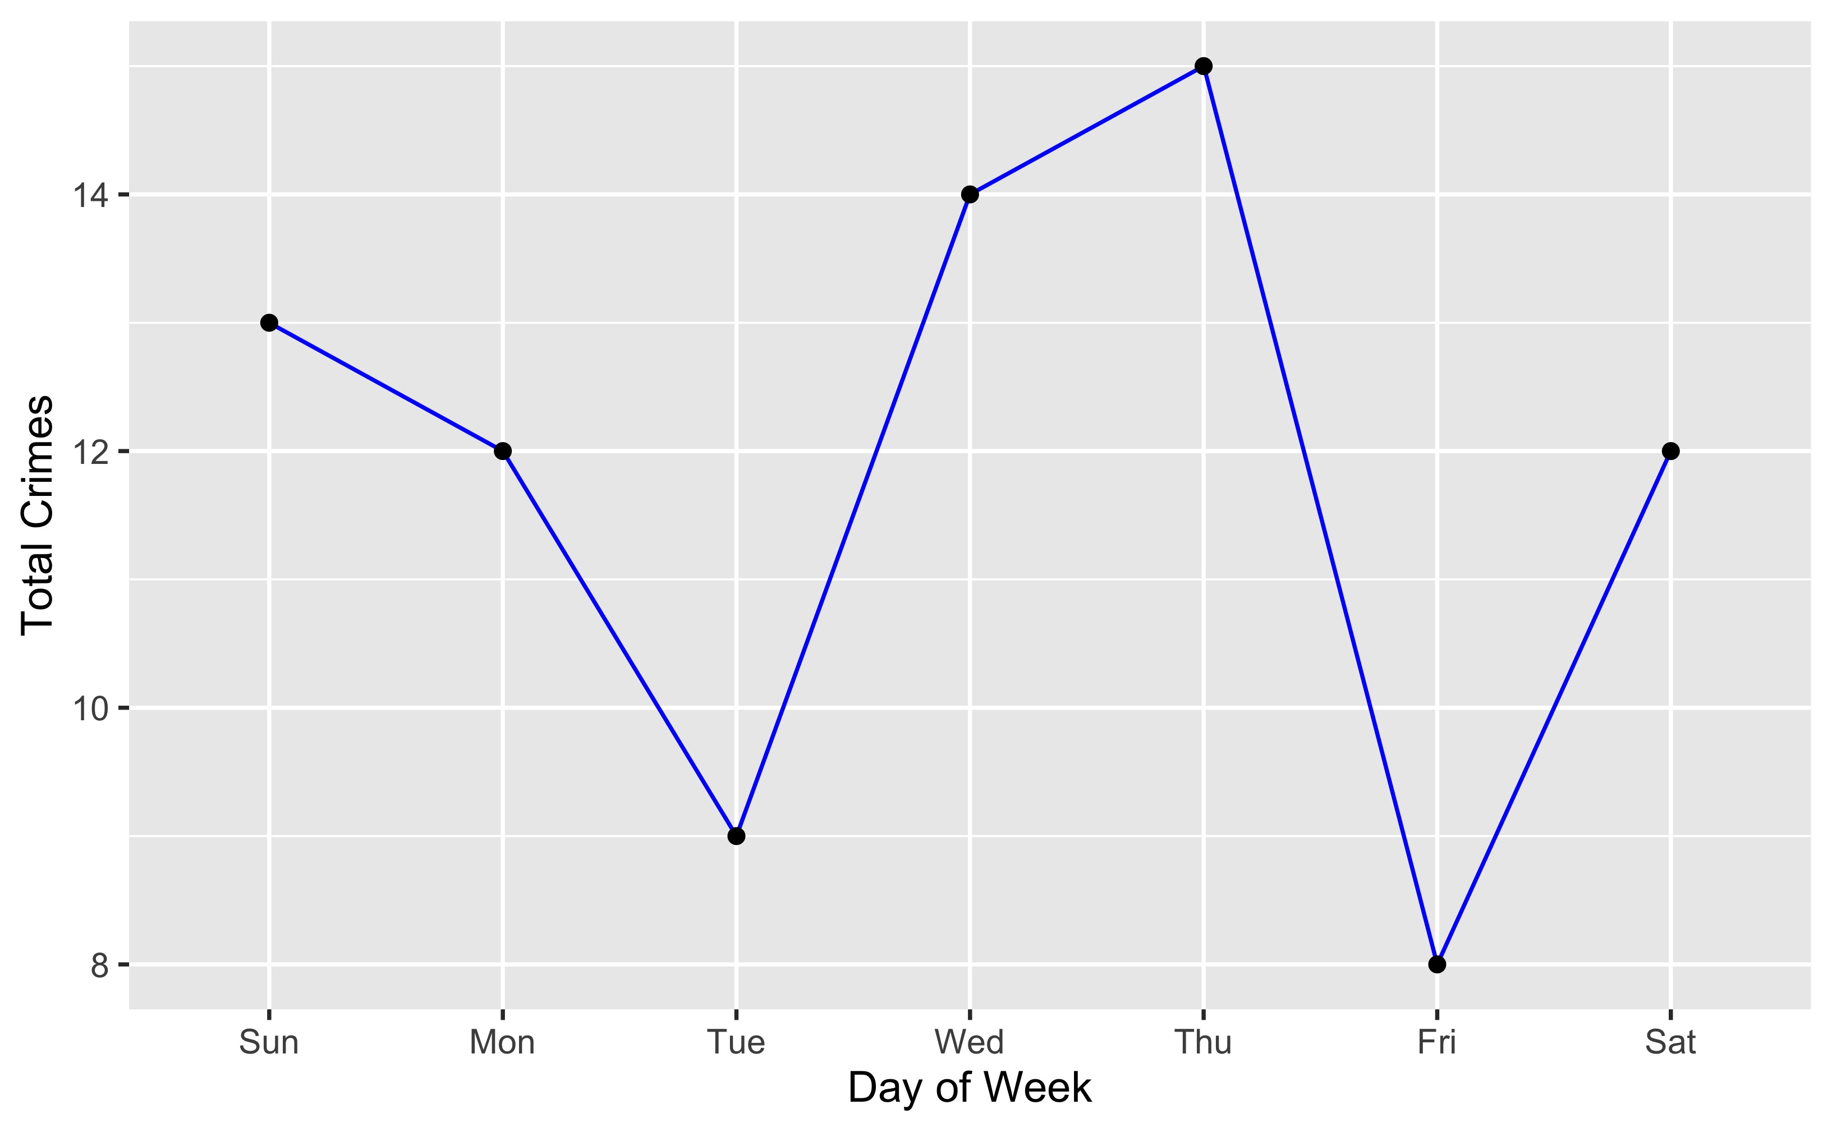
Central West End: Total Crimes by Days of the Week

Slide 37
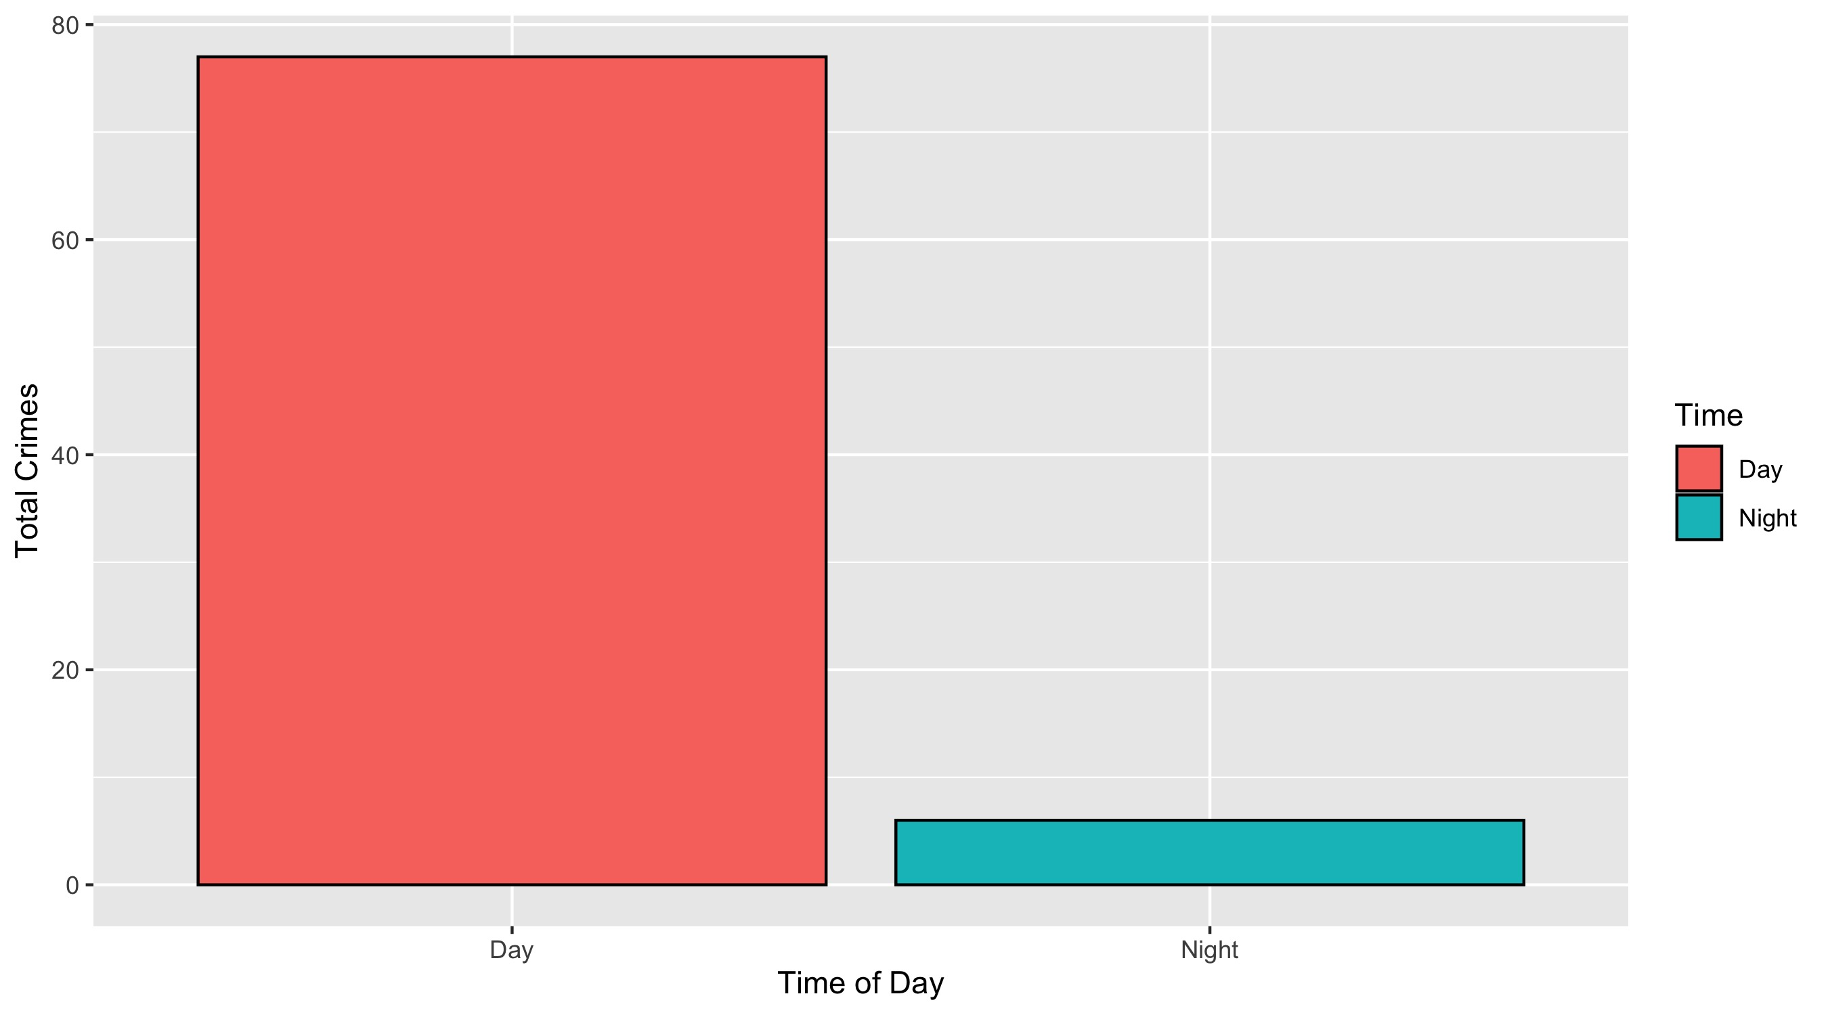
Central West End: Crimes by Time of Day

Slide 38
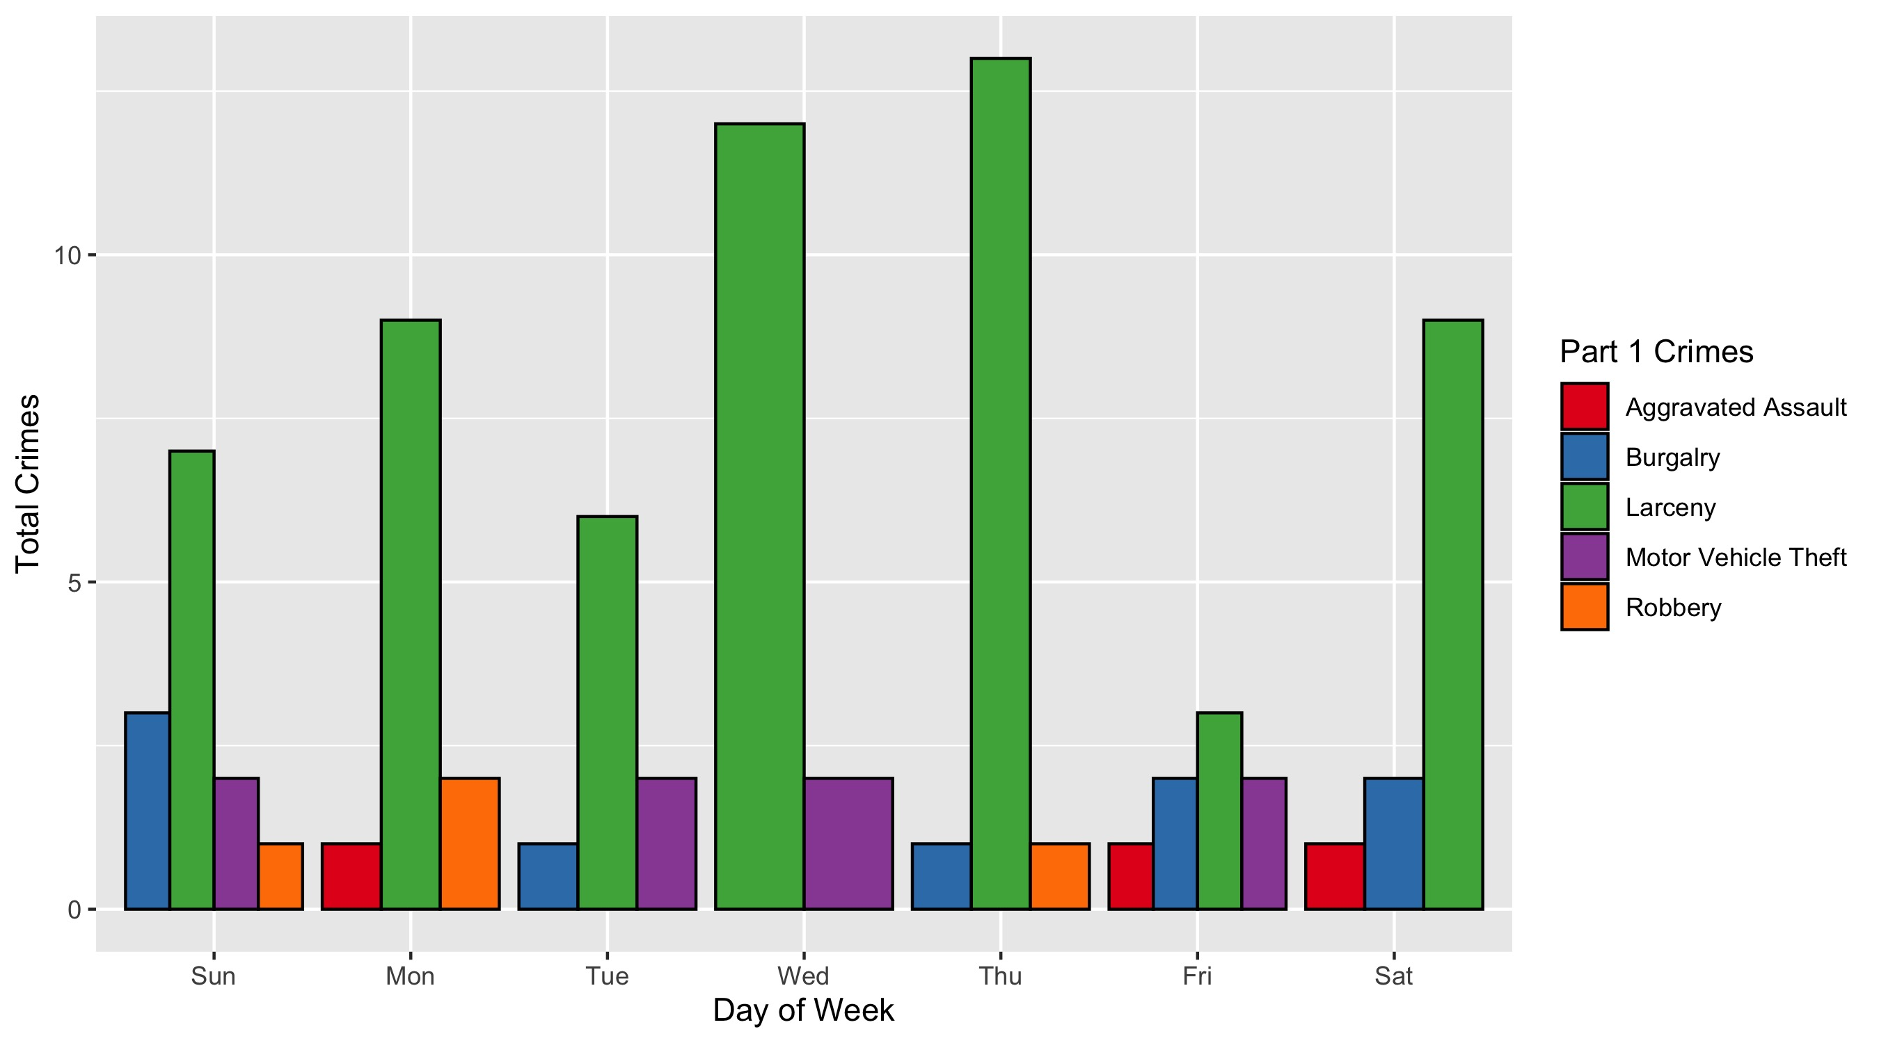
Central West End: Crimes by Day & Category

